Slide 1
Leadership Initiative

Slide 2
Early Childhood Personnel Center Mission
to facilitate the implementation of
integrated and comprehensive
early childhood systems
of personnel development (CSPD)
for all disciplines
serving infants and young children with
disabilities

Slide 3
Comprehensive System of Personnel Development
Recruitment and Retention
Strategies to identify, hire and maintain a qualified workforce across sectors and disciplines
Inservice Training
Ongoing learning activities to maintain and build the competence of the EC workforce
Leadership, Coordination & Sustainability
Structures for ongoing support of all personnel development activities
Personnel Standards
Discipline specific knowledge, skills and competencies for the EC workforce
Preservice Training
Formal program of study at an IHE to prepare for the EC workforce
Evaluation
Plans for evaluating each subcomponent of the CSPD

Slide 4
Comprehensive System Of Personnel Development
Leadership, Coordination & Sustainability
Structures for ongoing support of all personnel development activities
Recruitment and Retention
Strategies to identify, hire and maintain a qualified workforce across sectors and disciplines
Personnel Standards
Discipline specific knowledge, skills and competencies for the EC workforce
Preservice Training
Formal program of study at an IHE to prepare for the EC workforce
Inservice Training
Ongoing learning activities to maintain and build the competence of the EC workforce
Evaluation
Plans for evaluating each subcomponent of the CSPD

Slide 5
An Effective Comprehensive System of Personnel Development (CSPD)
Coordinates and addresses state needs for quantity and quality of ECI personnel and their need for training and support
Acknowledges the coordination between pre- and in-service personnel development (PD) to ensure consistency of practice
Uses ongoing evaluation via multiple sources to monitor child and family outcomes

Slide 6
A Comprehensive System of Personnel Development
is a necessary and integral
quality indicator of
an early childhood service system
AND
the early childhood workforce
who serve infants, toddlers and preschool children with disabilities and their families

Slide 7
ECPC Goals
Identify and Develop Knowledge
Develop or Identify Materials, Resources and Tools for the Early Childhood Workforce and those who Train Them
Provide TA to Specific Populations and State Early Childhood Systems
State Part C and Part B (619) Coordinators
IHE Faculty and Doctoral Students
State Systems

Slide 8
Comprehensive System of Personnel Development
Leadership, Coordination, & Sustainability | Quality Indicator 1: A cross sector leadership team is in place that can set priorities and make policy, governance, and financial decisions. Quality Indicator 2: There is a written multi-year plan in place to address all sub-components of the CSPD.
State Personnel Standards | Quality Indicator 3: State personnel standards across disciplines are aligned to national professional organization personnel standards. Quality Indicator 4: The criteria for state certification, licensure, credentialing and/or endorsement are aligned to state personnel standards and national professional organization personnel standards across disciplines.
Pre-service Personnel Development | Quality Indicator 5: Institution of higher education (IHE) programs and curricula across disciplines are aligned with both national professional organization personnel standards and state personnel standards. Quality Indicator 6: Institution of higher education programs and curricula address early childhood development and discipline specific pedagogy.
In-service Personnel Development | Quality Indicator 7: A statewide system for in-service personnel development and technical assistance is in place for personnel across disciplines Quality Indicator 8: A statewide system for in-service personnel development and technical assistance is aligned and coordinated with higher education program and curricula across disciplines
Recruitment and Retention | Quality Indicator 9: Comprehensive recruitment and retention strategies are based on multiple data sources, and revised as necessary. Quality Indicator 10: Comprehensive recruitment and retention strategies are being implemented across disciplines.
Evaluation of the System | Quality Indicator 11: The evaluation plan for the CSPD includes processes and mechanisms to collect, store, and analyze data across all subcomponents Quality Indicator 12: The evaluation plan is implemented, continuously monitored, and revised as necessary based on multiple data sources

Slide 9
Leadership, Coordination & Sustainability
Structures for ongoing support of all
personnel development activities

Slide 10
Leadership, Coordination, & Sustainability
Quality Indicator 1: A cross sector leadership team is in place that can set priorities and make policy, governance, and financial decisions.
Quality Indicator 2: There is a written multi-year plan in place to address all sub-components of the CSPD.

Slide 11
Leadership:
Nature (Characteristic You Were Born With)
Nurture (Behavior You Can Learn)

Slide 12
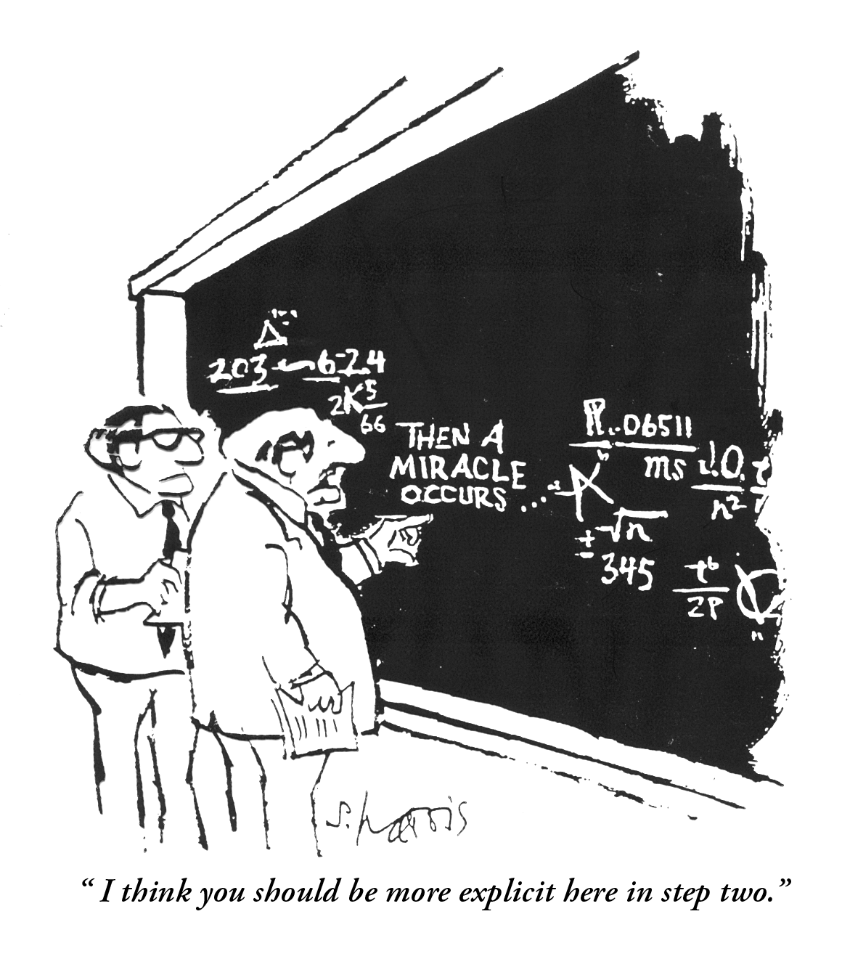

Slide 13
Differentiating between leader development
and leadership development. ...
Leader development focuses on developing individual knowledge, skills, and abilities (human capital).
Leadership development focuses on building networked relationships (social capital) among individuals in an organization.

Slide 14
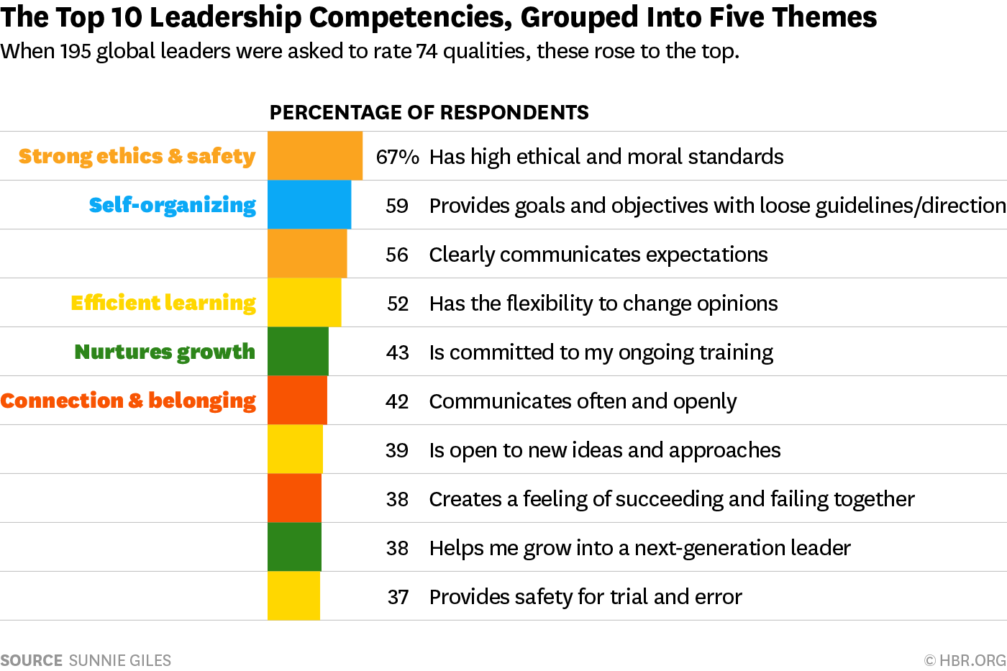

Slide 15
Fundamental Leadership Skills Ashkenas & Manville, 2018. HBR
Translate that vision into a clear strategy about what actions to take, and what not to do.
Recruit, develop, and reward a team of great people to carry out the strategy.
Focus on measurable results.
Foster innovation and learning to sustain your team (or organization) and grow new leaders.
Lead yourself — know yourself, improve yourself, and manage the appropriate balance in your own life.

Slide 16
Leaders Must:
establish and maintain principles that become inherent in the organization they are leading:
rationale environments
clear values
openness to change and innovation
maturity
space for people to grow
momentum effectiveness
stewardship
Bloch, 1996; DuPree, 1992

Slide 17
Knowledge
child development,
evidence-based practices,
state laws and regulations,
family-centered approaches,
federal laws and regulations, and
groupprocesses. Bruns et.al, 2017

Slide 18
Competencies
professional learning,
effective relationships,
shared responsibility,
data use,
and effective communication.
Bruns et.al, 2017

Slide 19
DEC Leadership Position Paper
Leadership capital is human capacities and organizational cultures that support “active engagement in leadership tasks”
Leadership capital is dynamic and can be shaped, built, or drained and used effectively or ineffectively
Bruder et.al, 2015

Slide 20
Valued Leadership Competencies
Having a clear purpose
Able to navigating complex systems
Able to develop a shared vision for the service delivery system
Able to build trusting relationships,
Able to take risks,
Able to collaborate

Slide 21
Leadership is a process of mutual influence and shared responsibility set in context.

Slide 23
Essential Characteristics of Leadership
Contextually Bound
Can Be Learned ( Using learning Theory)
The Harder the Task, The More Complex the Process of Leadership

Slide 24
Leadership defined:
the proactive process of influencing others “to act for certain goals that represent the values and motivations—the wants and needs, aspirations and expectations—of both leaders and followers” (Burns, 1978, p. 19)

Slide 25
The Most Essential Characteristics of Leadership (Bruder,2019)
Integrity
Moral Judgement
Courage

Slide 26
What characteristics are most important in your role? (n=72)
Ability to Advocate (3)
Ability to be a Systems Thinker (3)
Ability to Categorize Needs
Ability to Delegate (2)
Ability to Disseminate Information
Ability to Negotiate
Ability to Prioritize (2)
Accountable (2)
Adaptable
Analytical (3)
Approachable (2)
Articulate (3)
Attentive
Balance
Being a “Cheerleader”
Being a Good Listener (17)
Being an Enforcer
Being Present
Clarity
Collaborative (13)
Communicative (18)
Compassion
Confidence
Consistency (3)
Contemplative (2)
Creative (4)
Credible
Curious (4)
Decisive (3)
Dedicated
Diligent
Diplomacy
Empathy
Empowering
Encouraging
Engaged (2)
Fair (2)
Fiscally Savvy
Flexible (10)
Focused (6)
Generous
Good at Facilitation (3)
Good at Stress-Management
Good Problem Solving Skills (4)
Good Relationship Skills (12)
Good Team Building Skills (2)
Good Time-Management Skills (2)
Honest (4)
Humble (6)
Hungry
Inclusive
Inspiring
Integrity
Kind (2)
Knowledgeable (12)
Managerial
Motivated
Objective
Open-Minded (11)
Optimistic
Organized
Passionate (3)
Patient (7)
Perceptive
Persistent (3)
Persuasive
Positive (3)
Realistic
Receptive
Reflective
Relaxed
Reliable (2)
Resilient (4)
Resourceful
Respectful
Responsive (4)
Self-Driven
Self-Monitoring
Self-Motivated (2)
Sense of Humor (4)
Service Mentality
Steadfast
Strategic thinking
Strong (3)
Supportive (14)
Teamwork (3)
Tolerant
Transparent (2)
Trustworthy
Understanding (5)
Visionary
Willing

Slide 27
Methodology For Leadership Curriculum
Scan the Literature for leadership types
Research synthesis as frame
Think Tanks Part C/619 (2; N=21 participants)
a) Job descriptions/What you do/Need to know
b) Refine/reduce into critical knowledge and skills by level
c) Theme statements into categories
d) Translate into competency statements
4. Survey/Delphi for validation/consensus
5. Refined competencies will be sequenced by level
6. Indicators will be developed for each competency
7. Curriculum will be developed with learning activities

Slide 28
Leadership Beyond Role/Agency:EC Systems
Leadership within the Role/Agency: IDEA Programs
Coordinators Orientation and More

Slide 29
Definitions
Practice: the action of doing
Standard: What you must know and be able to do (knowledge and skills)
Competency: an ability or skill to meet a standard
Indicator: a rule for the measure of quality; a sign that shows the condition or existence of something

Slide 30
What does a Part C / 619 Coordinator need to DO? (level 2)
Strategic planning, vision, alignment
Use data to inform work
Grow and develop leader including family leader
Get on committees and state work groups so voices are hear
Communicate vision with other
Make good fiscal decisions that match vision; fiscal analysis
Provide guidance→ professional development, TA, EBP, innovations, policy decisions
Engender trust and be honest (being honest is a task as a good leader); don’t lie; if you can’t be honest/share information, explain why (authentic); be responsive
Give responsibility and visibility to others and nurture them

Slide 31
What does a Part C / 619 Coordinator need to KNOW (level 2)?
Know yourself through peer relationships and be reflective
Your revenue sources/amount of funding
TA opportunities
Cost to provide services
Know what your state isn’t doing (what other states have access to)
Know that you can outsource (if available)
Know your own strengths and weakness and those of your staff
Available resources around developing leaders
Staff professional development goals/career goals
Models for strategic planning and accessing TA
What has been done in the past/what does it look like/what can you change
Goals of leadership of your agency or state
Complete a needs assessment or know what providers need

Slide 32
What does a Part C / 619 Coordinator need to KNOW? (continued level 2)
How to facilitate activity
Impact the services provided have (long term)
Other social service systems
Where to get data/multiple outlets
What data is available
Effective communication techniques/platforms
Know your audience
Know your own communication style
Who you can train/who can help mentor or train your staff
Know what your leadership is comfortable with
What your stakeholders perceive about your authenticity
What does data tell us/what can it tell us? Understanding of data
How to find, recruit, and meaningfully include advocates (i.e. families); add new voices to conversation
Address the needs of the changing population

Slide 33
Level 1 “KNOW” | Level 1 “DO”
Content knowledge; mission; system needs; how to find information; don’t have to know it all; don’t take things personally; understand political landscape; how/where to get data; who are your interagency partners; committees/meetings; what is already in place; organize/prioritize | Face to face relationships; focused/disciplined; trust; delegate; be honest; get to know your EC partners; attend relevant meetings

Slide 34
Level 3 “KNOW” | Level 3 “DO”
Implementation science How to be comfortable in uncomfortable situations | Make adaptations based on data Lead by example Use data to inform decisions Validate work of others and celebrate success

Slide 35
Level 3 “KNOW” | Level 3 “DO”
Who your interagency partners are What your state leadership wants/finds meaningful National practices/differences | Build meaningful connections between your programs/collaborate Adapt to changing political or other circumstances Network, share information, communication, get information to use in your state

Slide 36
Level 3 “KNOW” | Level 3 “DO”
EC partners and initiatives Discuss fiscal resources with EC partners Know political climate | EC advisory committees Money on the table with hands off Be purposeful and smart

Slide 37
Methodology For Leadership Curriculum
Scan the Literature for leadership types
Research synthesis as frame
Think Tanks Part C/619 (2; N=21 participants)
a) Job descriptions/What you do/Need to know
b) Refine/reduce into critical knowledge and skills by level
c) Theme statements into categories
d) Translate into competency statements
4. Survey/Delphi for validation/consensus
5. Refined competencies will be sequenced by level
6. Indicators will be developed for each competency
7. Curriculum will be developed with learning activities

Slide 38
Themes from the Raw Data
Federal Program Requirement
State Program Management
Professionalism
Stakeholder Engagement
Strategic Thinking

Slide 39
Performance Categories
Federal Program Requirement
State Program Management
Professionalism
Stakeholder Engagement
Strategic Thinking
Level 3
Level 2
Level 1
 | Federal Program Requirement | State Program Management | Professionalism | Stakeholder Engagement | Strategic Thinking

Slide 40
ECPC Leadership Competencies Prioritized

Slide 41
Level 1
Federal Program Requirement
Federal requirements
Federal and local statute/laws/rules
SSIP/APR; data collection, data review, ongoing implementation
General supervision
Oversight of general supervision
Grant applications
Review legislation
Compliance monitoring
OSEP application
Establishing activities to support APR (LRE, child outcomes)
Budget analysis/plan how to spend money
Grant system, changes to grants, fiscal management
Manage budget
Budget planning/fiscal management
Advise RFP process/procurement
Create reports when requested
Managing/monitoring data/data systems(both)

Slide 42
Level 1
State Program Management:
Manage budget
Budget planning/fiscal management
Review IEPs/IFSPs
Monitor local programs (monitoring)
Listening sessions/public hearings
Interpret and modify procedures
Clarify policy and refer to handbook/regulations
Updating guidance documents/policy manuals
Quality assurance—state/local
Site visits
Determinations
Go on site to investigate complaints
Often go on site to visit local programs
Child find activities
Coaching staff/writing staff reviews
“Coaching up”
Manage people
Morale building/building relationships
Supervising staff
Targeting with staff
Work with consultants (manage people/activities)
Project management
Approve time sheets/time off requests
MOU
Deal with HR/hiring/onboarding
Time management
Managing other programs
Hiring staff
Supervise staff/hiring/HR
Contract management
Billing waivers
Manage and monitor contracts
Collect data/review/analyze data
Checking data
Data management
Managing/monitoring data/data systems
IT/security/data system
Create reports when requested
Read emails
Answer phone calls
Meetings/virtual meetings
Field calls/complaints
Writing
Sharing information
Question procedures
Preparing reports
Organizing notes/schedule
Agency required meetings/trainings
Training
TA to families/school districts
TA- 50,000 agency initiatives
National COPS/learning communities
CSPD activities
TA and PD activities
Keep child with disability at every table of 10 called in as the expert
Family centered practices
Grant meetings
Oversight of statewide initiatives
Political have-to’s; politically motivated tasks
Checking on accountability

Slide 43
Level 1
Professionalism:
Verbal recognition
Self-care
Validating practice
Navigate conversations to promote quality and compliance- both state and federal
Balance between compliance and quality –both state and federal

Slide 44
Level 1
Stakeholder Engagement:
Create newsletters
Website
Stakeholder input (listen)
Represent agency
Represent (part C) in other groups/advocacy
Defining role in relationships- see what’s working
Interagency collaborative meetings
ICC- statewide and local activities
Responding to legislature
Adjustments within each new administration
Legislative questions
Statewide boards, commissions
Collaboration (between C/619)
Building relationship between B and C interagency collaboration
Push and pull between two agencies, balance conflicting priorities
Communication with local providers (meetings, newsletters, webinars)
Advocate for position

Slide 45
Level 1
Strategic Thinking:
Long term planning/system development
Reading/learning- staying up to date on research
Outreach and increasing sphere of influence
Research other EC/ECSE programs

Slide 46
Level 2
Federal Program Requirement:
Monitor legislation for potential impact and feed to appropriate agency personnel
Evaluate/interpret legislative proposals/take position

Slide 47
Level 2
State Program Management:
How to be aware of staff’s comfort level with recognition; relationship building
Keeping your people, “core” to your agency needs
Share tools to help others do their job
Encouraging your staff to be innovative
Give advice/advise commissioner
Let senior management know about potential push back from changes/complaints; no surprises
Inform senior management with an “elevator speech” (talking points) of fun facts about your program
Monitor legislation for potential impact and feed to appropriate agency personnel
Know what everyone else does in your agency
Be responsive to other agency initiatives
Make sure full agency understands what program is/is not
Know training, infrastructure
Good understanding of state system speed; most things done happen quickly
Find state strengths to support growth of agency
Be aware of what is going on so you can leverage national/state resources and share initiatives Observation of the foundation (check the climate)
Be at the table for all the grant writing
Evaluate/interpret legislative proposals/take position
Insure people in your department; know who you are, know your position/program, why your program should or should not be at the table
Be an advocate for your children with disabilities
Represent families and infants/children with disabilities in every discussion
“Wiggle” in the door; be a champion for all kids

Slide 48
Level 2
Professionalism:
Recognition of excellence; working together as a team
Have an arsenal of motivational strategies
Provide opportunities
Check ourselves (am I modeling successfully? Am I doing what I need to support staff?)
Show that your passionate about your work
Passion; have it, share it; be tenacious, persistent, push the envelope, bust myths, tell real story of the program without being perceived as pushy
Be a team player
Be a connector; not isolated
Be a good communicator; how things happen in your program and vice versa
Common language
Establishing communication and trust
Be professional
Let people know what you can do
Don’t take things personally; have a thick skin
Stay sane

Slide 49
Level 2
Stakeholder Engagement:
Be a cheerleader
Advocate/sell your program; shared sense of agency
Program champion/cheerleader
Answer the door when opportunity knocks
Look for opportunities to collaborate
Work the ICC to promote what the system needs
Interagency and inter-department collaboration
Promote engagement with stakeholders
Know how to collaborate across departments in agency (vertical)
Establish feedback loop with locals (meetings/surveys)
Good elevator speech

Slide 50
Level 2
Strategic Thinking:
Be political, pick battles
Always be thinking of new initiatives that fit within the goals/mission/vision of the larger agency
Be innovative (find new solutions)
Articulate the vision
Speak to long term vision, mission
Paint a picture of the future; where everyone fits
Action planning/strategic planning
Be strategic, push certain agendas
Evaluation for your strategic plan; are you where you wanted to be? How do you align with full agency plan?
Vision/mission based on data/stakeholders with action plan and strategies liked to vision/mission

Slide 51
Level 3
Federal Program Requirement:
Know when federal grants are coming; laws/regulations changing; what peer states are doing

Slide 52
Level 3
State Program Management:
Attend board meetings
Demonstrate that you value the work of other EC programs
Know national scene
Understand purpose of funding for all programs in state
Review data to provide guidance to parents, schools, providers
Research to bolster capacity
Data sharing
Disseminate information (e.g. OSEP) to colleagues
Building materials for staff/providers
Present at any EC meeting/initiative- invite yourself if needed, or ask someone to represent C/619
Know fit within the system

Slide 53
Level 3
Professionalism:
Flexibility to move through roles as needed
Self-care/self-reflect
Make commitments and follow through with obligations
Values put in place
Choose your battles
Be present
Attend conferences/institutes/meetings to learn/grow/share ideas
Bring back information from national conferences

Slide 54
Level 3
Stakeholder Engagement:
Be a voice
Use a common vocabulary
Bring value to table
Get out to as many stakeholder groups as possible
Promoting/educating about the program
Building relationships with partners
Be mindful of bigger picture- how to promote for agency not just EI
Show the connection between agencies- show how families/kids will benefit
Continue to build collaborations between agencies, be supportive, build support
Acknowledge the competition for resources and learn to partner to use limited resources
Relationship building across agencies
Demonstrate that you value the work of other EC programs
Offer to participate in other EC initiatives/TA/PD
Find common threads across agencies/EC programs
Invite other EC programs to your table
Make presentations statewide on EI to dispel myths
Cross-pollinate group to group by inviting someone from one group to another group
Find opportunities to share resources and information with your EC contacts in other agencies
Look for opportunities to promote Part C/619 outside the agency
Build relationships with champions in the legislature
Strengthen/partner with IHE- know standards
Bring new/diverse stakeholders
Assure it is clear where birth to five sits in the big picture
External work
Have champions
Bind the relationship; work beyond the person

Slide 55
Level 3
Strategic Thinking:
Be mindful of bigger picture- how to promote for agency not just EI
Bring audacious ideas
Long-term prep—your success is our success
Need to be successful after exiting the system
Two gen focus

Slide 56
Methodology For Leadership Curriculum
Scan the Literature for leadership types
Research synthesis as frame
Think Tanks Part C/619 (2; N=21 participants)
a) Job descriptions/What you do/Need to know
b) Refine/reduce into critical knowledge and skills by level
c) Theme statements into categories
d) Translate into competency statements
4. Survey/Delphi for validation/consensus
5. Refined competencies will be sequenced by level
6. Indicators will be developed for each competency
7. Curriculum will be developed with learning activities

Slide 57
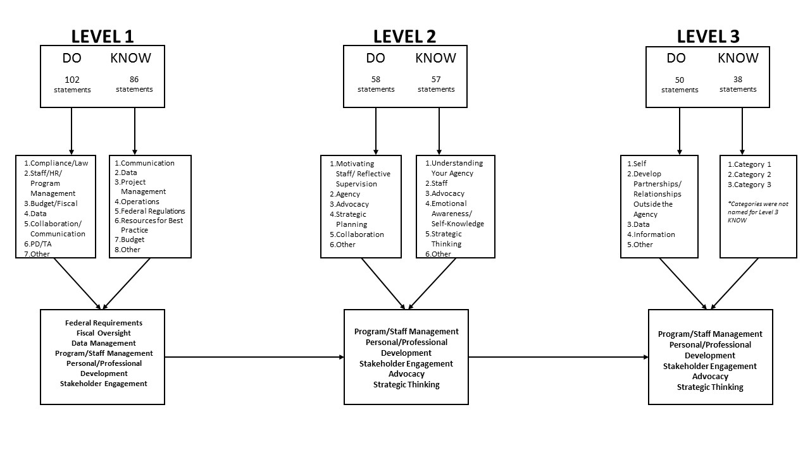
Data Collection/Reduction Methodology

Slide 58
Example: Strategic Thinking
Initial Raw Data
Be mindful of bigger picture
Bring audacious ideas
Long-term prep—your success is our success
Need to be successful after exiting the system
Data Reduction Category
Strategic Thinking
Develop Partnerships/Relationships Outside the Agency
Final Competencies
Uses a team approach for problem solving and program management of the state early childhood system
Facilitates statewide meetings in the early childhood system
Develops action plans and timelines for achievement of objectives in prioritized areas of early childhood service delivery
Develops a logic model to evaluate the state early childhood system

Slide 59
Directions on Survey
Items Listed by Level and Area
For each item please check whether this is a valid description of what you do or want to do as a leader
At the End of Each Area by Level
Please tell us what the 2 most important item in this Areas is

Slide 60
We have taken the data you generated about what you do and what you need to know as leaders and started our date reduction and progression into competencies. We have tried to minimize the competencies and will put indicators and knowledge statements next to the final grouping of competencies.
As a reminder we have three tiers of leadership generated by you through two think tank meetings.
Tier 1 is management or administrative leadership.
Tier 2 is leadership in your program’s agency
Tier 3 is leadership across all early childhood initiatives.
My request:
Could you please take the following validation survey

Slide 61
Directions on Survey
Items Listed by Level and Area
For each item please check whether this is a valid description of what you do or want to do as a leader
At the End of Each Area by Level
Please tell us what the 2 most important item in this Areas is

Slide 62
Federal Program Requirements
Level 1 |  | Level 2 |  | Level 3
Implements and complies with federal laws, regulations, policies, and requirements for the IDEA Part C/619 program | 98% | Implements and complies with federal laws, regulations, policies, and requirements for programs in the state agency in which the Part C/619 program resides | 80% | Implements and complies with federal laws, regulations, policies, and requirements for early childhood programs | 87%
Applies current and emerging federal policies, practices, and resources to the Part C/619 state program | 63% | Monitors, interprets and communicates proposed federal laws, regulations, policies, and requirements for the IDEA Part C/619 programs to relevant state agency staff | 59% | Monitors, interprets and communicates proposed federal laws, regulations, policies, and requirements in early childhood to relevant state agency staff | 79%
Develops, manages, and analyzes a data system for federal reporting purposes | 61% | Communicates and disseminates any emerging federal initiatives for the Part C/619 program to your agency supervisor | 59% | Communicates to your agency supervisor any emerging federal initiatives in early childhood | 55%

Slide 63
State Program Management
Level 1 |  |  | Level 2 |  | Level 3
 | Implements and complies with state laws, regulations, policies, and requirements for the IDEA Part C and 619 programs | 90% | Implements and complies with state laws, regulations, policies, and requirements for programs in the state agency in which the Part C/619 program resides | 80% | Implements and complies with state laws, regulations, policies, and requirements for statewide EC programs | 80%
 | Develops, implements and monitors state policies and procedures for all aspects of the Part C/619 program | 81% | Monitors, interprets and communicates proposed state laws, regulations, policies, and requirements for the IDEA Part C/619 programs to relevant state agency staff | 63% | Monitors, interprets and communicates proposed state laws, regulations, policies, and requirements for state EC programs to relevant state agency staff | 67%
 | Develops, implements, and monitors state and local program implementation of the service delivery system for the Part C/619 program | 57% | Identifies and coordinates state agency initiatives that affect the Part C/619 program or staff | 38% | Initiates/ participates in state EC leadership team | 48%

Slide 64
Fiscal Management
Level 1 |  |  | Level 2 |  | Level 3
 | Prepares, manages, revises (when needed) and reconciles the federal budget allocation for the Part C/619 program | 78% | Integrates the federal budget allocation for the Part C/619 program with the state agency budget | 67% | Integrates the federal budget allocation for the Part C/619 program with state early childhood funding streams | 51%
 | Prepares, manages, revises (when needed) and reconciles the state’s budget for the Part C/619 program | 78% | -- | -- | Develops/coordinates and interagency fiscal plan for early childhood | 51%
 | Develops, implements and monitors state contracts and MOUs for payments for early intervention/special education services | 70% | -- |  | --

Slide 65
Stakeholder Engagement
Level 1 |  |  | Level 2 |  | Level 3
 | Communicates effectively through listening, talking and writing for a variety of audiences | 75% | Communicates current and emerging state IDEA program agency laws, regulations and policies, practices, and resources to Part C/619 stakeholders | 69% | Collaborates with relevant state agencies and staff on early childhood initiatives that include Part C/619 | 75%
 | Develops a plan to receive to receive state and local feedback from stakeholders about implementation of the Part C or the 619 program | 45% | Collaborates with relevant state agency staff or programs on initiatives relevant to Part C/619 | 63% | Represents the Part C/619 program in all interagency early childhood state meetings | 72%
 | Represents the Part C/619 program on federal, state or local boards or committees as requested | 43% | Represents the Part C / 619 program in all state agency meetings | 57% | Communicates current and emerging state agency laws, regulations and policies, practices, and resources to early childhood stakeholders | 62%

Slide 66
Strategic Thinking
Level 1 |  |  | Level 2 |  | Level 3
 | Develops goals, objectives, activities, timelines and measurable benchmarks to prioritize Part C/619 state activities | 67% | Uses a team approach for problem solving and program management of the Part C/619 program | 90% | Uses a team approach for problem solving and program management of the state early childhood system | 87%
 | Assesses the implementation of the Part C/619 program using self-assessments | 67% | Uses data from a variety of sources (e.g. the EC system framework, state needs assessments) to set priorities for the Part C/619 program | 87% | Uses data from a variety of sources (e.g. state needs assessments) to set priorities for a statewide early childhood system | 73%
 | -- |  | Develops action plans and timelines for achievement of objectives in prioritized areas of improvement for the Part C/619 program | 65% | Develops action plans and timelines for achievement of objectives in prioritized areas of early childhood service delivery | 65%

Slide 67
Professionalism
Level 1 |  |  | Level 2 |  | Level 3
 | Disseminates evidenced based intervention practices to local program administrators and practitioners who deliver intervention in the Part C and 619 program | 88% | Communicates the vision of your Part C/619 program in federal, state and local venues | 79% | Disseminates evidenced based intervention practices to administrators and practitioners across sectors in the early childhood system | 74%
 | Disseminates information and training to local program administrators and practitioners about current and emerging research and practice for the Part C and 619 program | 87% | Disseminates information and training to state and local program administrators and practitioners about current and emerging research and practice for the Part C and 619 program | 73% | Communicates the vision of the state early childhood system in federal, state and local venues | 63%
 | Prioritizes competing professional responsibilities | 85% | Uses an evidenced based framework to develop implementation plans for scaling up effective intervention program practices | 63% | Uses an evidenced based framework to develop implementation plans for scaling up effective early childhood program practices | 62%

Slide 68
Leadership Competencies Results

Slide 69
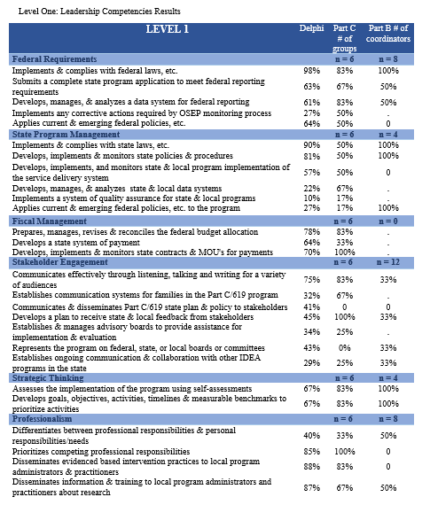

Slide 70
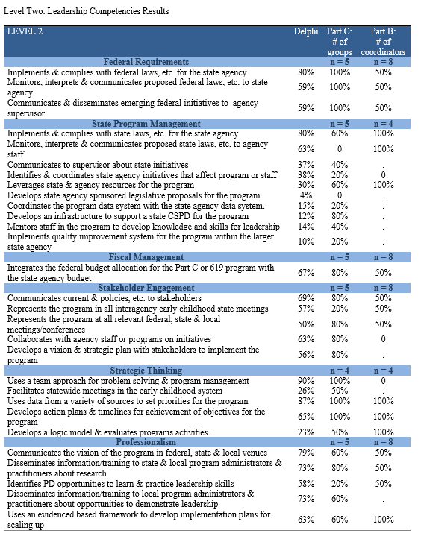

Slide 71
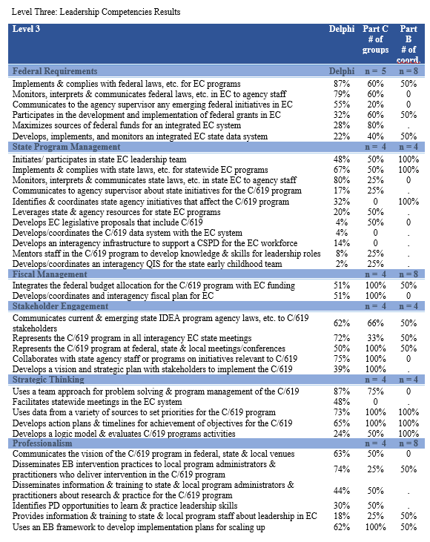

Slide 72
ECPC Metasynthesis of Leadership Studies | Kagan | ECPC C/619 Coordinator Developed | CT PreK -3 | Aspire | ECSEL | CEC/DEC Advanced Specialty Set | MCHB LEND | ASHA
 |  | Leading Self |  | Leading Self | Personal Leadership |  | Self | Emotional Intelligence, Introduction to Leadership
Organizational Visioning, Coaching, Confidence Building Practices, Soliciting Creative Employee Solutions | Community | Stakeholder Engagement |  | Leading Others | Collaborative Leadership | Collaboration | Others | Coaching, Influencing Others, Conflict Management,
 | Pedagogical |  | Curriculum and Instruction | Leading Learning | Leadership for Instruction Leadership for Student Services | Curricula Content Knowledge
 |  | Federal and State Program Requirements | Federal and State Program | Leading Implementation of Policies, Laws and Regulations | Institutional Leadership | Programs, Services and Outcomes
 | Administrative | Federal and State Program Management |  | Managing Operations and Resources | Organizational Leadership |  |  | Teams, Virtual Meetings,
 | Conceptual | Strategic Thinking | Leading for Equity, Excellence and Early Success | Leading Results |  | Research and Inquiry | Wider Community | Leadership Styles, Generative Thinking, Change Leadership,SP
 | Advocacy | Professionalism |  |  |  | Professional and Ethical Practice

Slide 73
CEELO
Webinar 1: Introduction to Leadership in a SEA, Levels of Leadership, Problems of Practice as Opportunities for Learning, Achieving Competence, the CEELO Leadership Toolkit
Webinar 2: Management or Leadership, Leadership Boundaries, High-performing State Offices of Early Learning, Aligned Contributors and Contributions
Webinar 3: Data and Results-based Accountability, Results-based Leadership and Facilitation, Mental Models, Action Commitments
Webinar 4: Ingredients for Improvement, Collective Leadership Cycle, Revisiting Levels of Leadership

Slide 74
Tasks the Next TWO Days
Finalize the DRAFT Scope and Sequence
Finalize Methods
Compile Materials, Tools and Resources
Plan Pilot

