Slide 1
Child Development and Early Learning
Initial Practice-Based Professional Preparation Standards Early Interventionists/Early Childhood Special Educators
1.1

Slide 2
Standard 1
Candidates understand the impact of different theories and philosophies of early learning and development on assessment, curriculum, instruction, and intervention decisions. Candidates apply knowledge of normative developmental sequences and variations, individual differences within and across the range of abilities, including developmental delays and disabilities, and other direct and indirect contextual features that support or constrain children’s development and learning. These contextual factors as well as social, cultural, and linguistic diversity are considered when facilitating meaningful learning experiences and individualizing intervention and instruction across contexts.

Slide 3
Component 1.1
1.1 Candidates demonstrate an understanding of the impact that different theories and philosophies of early learning and development have on assessment, curriculum, intervention, and instruction decisions

Slide 4
Objectives
Describe key theorists and their theories on early development and learning that influence EI/ECSE
Describe the influence of theories on early development and learning on assessment, curriculum, intervention, and instructional decisions
Notes:
Facilitator: remind participants to take notes throughout the review of developmental theories as they will need this information for the planned activity at the end of the presentation

Slide 5
Theory
Defined as an orderly, integrated set of statements that describes, explains, and predicts behavior
Influenced by cultural values and belief systems
Continued existence depends on scientific verification:
Set of research procedures agreed by the scientific community
Endure or replicated over time
Notes:
(Berk, 2019)

Slide 6
Nature vs. Nurture Child Development Theories
Nature
All genes and hereditary factors influence who we are and are not likely to vary much across a lifetime
Physical traits, personality characteristics, intellectual or creative traits
Heredity is most important
Notes:
Example – practice of phrenology – where the shape of an individual’s head was thought to dictate all other characteristics

Slide 7
Nature vs. Nurture continued
Nurture
Environmental variables impact who we are
How we are raised
Social relationships
Surrounding culture
Notes:
Many more theories that have evolved and been supported by evidence over time believe that our development is shaped – to varying degrees – by environmental variables – for instance, early experiences, cultural influences, relational variables.

Slide 8
Behavioral and Developmental Theory
Behavioral theory: the core of special education research and practice
Developmental theory: informs application of practices to young children and early learners
Piagetian Theory
Vygotskian Theory
Attachment Theory
Notes:
Current EI/ECSE practice is firmly rooted in the evidence base that has unfolded over decades of research and revision of theories of child development that include elements of both nature and nurture, although each of these theories holds different positions about the degree of impact each holds for human development.
The major theories that we use today carry with them a long history of scientific inquiry, which have evolved over time to inform both the developmental manner in which humans grow and change as they move through the life span, and also describe the many variables that impact behavior, the central thrust of behavioral theory as we will see.

Slide 9
Systems Theories
Ecological and Transactional Models
Sameroff: Transactional Model
Bronfenbrenner/Ecological Systems of Theory
Neuroscience of Early Childhood
Notes:
Ecological and transactional models also describe how external influences – not just at the child and family level – work in systems over time and place to impact the trajectory of human development.
Each of these models holds vital information that relate to the work we do with children and families.
Over time, our work with young children has evolved to include the active ingredients of a number of major theories, which now serves as a primary or unified set of practices for the field of EI/ECSE (e.g., Odom & Wolery, 2003)
Lets take some time to examine 3 types of theories that lie at the core of EI/ECSE practice:

Slide 10
Foundations of Behavioral Theory
Directly observable events are only appropriate targets of the study of child learning and behavior
Measurable stimuli and behavioral responses
Originated with Pavlovian experiments with dogs to demonstrate classical conditioning
Notes:
Let’s begin with the behavioral perspective. Behavioral theory states that only directly observable events are appropriate targets of the study of child learning and behavior
These events are simple: measurable stimuli and behavioral responses to stimuli
Originated with Pavlovian experiments with classical conditioning
Dog studies
John Watson (1878-1958)
Baby Albert
Believed that behavior can be molded by carefully developed stimulus-response associations over time in a continuous process
B.F. Skinner (1904-1990)
Operant conditioning – reinforcers and punishers can be developed to individualize and modify response behaviors
Skinner Box

Slide 11
B.F. Skinner
Developed Operant Conditioning – reinforcers and punishers can be developed to individualize and modify response behaviors
Led to broader use of behavior modification interventions, primarily tested in clinical settings on older children and adults with cognitive impairments
Notes:
B.F. Skinner (1904-1990)
Operant conditioning – reinforcers and punishers can be developed to individualize and modify response behaviors
Skinner Box

Slide 12
Applied Behavior Analysis (ABA): Key Concepts
Three-part contingency (antecedent-response-consequence)
Systematic use of behavioral strategies - modeling, prompting, shaping, chaining, and differential reinforcement to support positive outcomes
Fidelity use of functional behavior assessments and development of appropriate behavior intervention plans
Notes:
Three-part contingency (antecedent-response-consequence)
The systematic use of behavioral strategies such as modeling, prompting, shaping, chaining and differential reinforcement to support positive behavioral outcomes
Fidelity use of functional behavior assessments and development of appropriate behavior intervention plans
Data collection guides assessment, planning, intervention, and evaluation.
Supports appropriate behavior by teaching new skills
Modifies the environment to prevent challenging behavior
Puts prevention strategies in place before new behaviors occur

Slide 13
ABA – Key Concepts
Data collection guides assessment, planning, intervention, and evaluation.
Supports appropriate behavior by teaching new skills
Modifies the environment to prevent challenging behavior
Puts prevention strategies in place before new behaviors occur

Slide 14
Activity
After watching the video on the next slide, discuss the assessments and interventions used in EI/ECSE that are based in behavioral theory

Slide 15
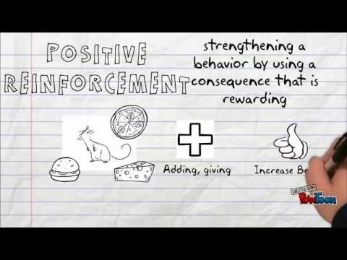
Video: A Look at Behaviorism
https://youtu.be/eLaa8cgljKk
Notes:
https://youtu.be/eLaa8cgljKk

Slide 16
The Developmental Perspective
Behavioral practices for individuals with disabilities originally developed for older children and adults in highly controlled circumstances
Increased focus on early learning and intervention for young children in the context of caregiving required a blending of theories
Modern EI/ECSE practice grounded in multiple theories
Notes:
Behavioral and developmental research are rooted in fairly distinct perspectives, theories, and methodologies, with different implications for clinical practice.
Behavioral scientists over the decades have not integrated the rich body of information on typical child development when formulating behavioral interventions - focused on discrete skills rather than on developmentally appropriate learning targets (Schreibman, 2015)
As the ability to identify developmental problems early in life progressed, researchers and practitioners began to integrate developmental theories into their practice to ensure that teaching and interventions were relevant to the very young child, with the caregiving context.
Rooted in multiple disciplines, including psychology, cognitive science, and neuroscience
Lets review 3 of these foundational theories:

Slide 17
3 Developmentally-Based Theories
Piaget: Cognitive developmental theory
Vygotsky: Sociocultural theory
Attachment Theory
Notes:
We will now take a look at 3 theories often used today in EI/ECSE practice that use a developmental lens:

Slide 18
Jean Piaget: Cognitive-Behavioral Framework
One of the most influential theorists of modern child developmental theory
Did not believe that child learning required the use of reinforcers such as praise or rewards from adults
First to closely study the way children actively engaged with the physical world to learn
Notes:
One of the most influential theorists of modern child developmental theory
Did not believe that child learning required the use of reinforcers such as praise or rewards from adults
Piaget was the first to closely study the way children engaged with and understood the physical world, and their reasoning about the social world. His contribution to the study of child development promoted the development of specific curriculums designed to promote child-led discovery learning and a hands-on approach to early education.

Slide 19
Schemas: Frameworks for Understanding
“Building blocks” of knowledge
Helps children organize and make gradually more complex meaning of the world
Children gradually transition from simpler ways of understanding to more complicated ones, using a string of organizing experiences over time
Notes:
Piaget called the schema the basic building block of intelligent behavior – a way of organizing knowledge. Indeed, it is useful to think of schemas as “units” of knowledge, each relating to one aspect of the world, including objects, actions, and abstract concepts.
For example, a child is pushing a doll around in a stroller, which is one simple schema. He then decides to feed her a plastic carrot while he is pushing her, which layers a second schema into his play. If he would then tell his mother, “we are going to go to walk to the park now” he is combining schemas to engage in early pretend play – a first step towards representational thought.

Slide 20
Piaget: 3 Basic Concepts
Schema: a mental structure we use to organize our perceptions and memories
Assimilation: use of existing schemas to build on our stores of knowledge and skills
Accommodation: “building” or creating new schemas (involves deeper change)
Notes:
Piaget believed that children develop a scheme for any given element of learning, and use that schema to build new information to build new skills. In a cyclical manner, the child then accommodates to the new level of understanding and competence as he or she is again ready to learn something new and more complex.
Schema: a mental structure we use to organize our perceptions and memories
Assimilation: use of existing schemas to build on our stores of knowledge and skills
Accommodation: “building” or creating new schemas (involves deeper change)

Slide 21
Piaget: 4 Stages of Development
STAGE | PERIOD OF DEVELOPMENT | DESCRIPTION
Sensorimotor | Birth – 2 years | Explores with all senses, hands, mouth. Works out making things happen (cause and effect), finding hidden objects, filling and emptying
Preoperational | 2-7 years | Begins to use symbols, language, pretending, story-telling
Concrete Operational | 7-11 years | Logic and reasoning become more organized: interested in classifying objects into hierarchies
Formal Operational | 11 + | Abstract and systematic thinking requiring higher-level cognitive processes
Notes:
Although scientific work done since the time when these 4 stages was first developed suggests that children develop the ability to think abstractly and to understand the mind of another much earlier than Piaget thought, these stages are still useful for understanding the basic sequences of how cognition unfolds:

Slide 22
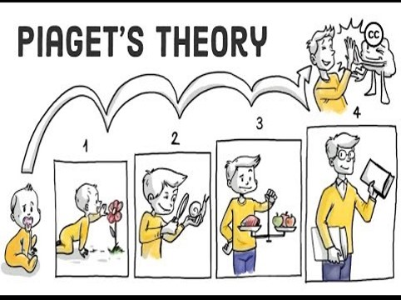
A Look At Piaget
https://youtu.be/IhcgYgx7aAA
Notes:
https://youtu.be/IhcgYgx7aAA

Slide 23
Activity
As a group, discuss assessments you have used that incorporate Piaget’s stages as a means of describing a child’s cognitive development.
How can knowledge about each of these stages provide useful information for IFSP/IEP planning?

Slide 24
Sociocultural Theory: Vygotsky
Believed that knowledge takes place in the context of social interactions
Through interactions with others, children acquire the capacities and skills they need in the context of their own culture
Notes:
While Vygotsky agreed with Piaget that children were active learners and acquired knowledge through experiences, he believed that knowledge assembled through social interaction rather than acquired independently by the child in a biologically programmed set of stages
Through interactions with adults and older children, children acquire the capacities and skills they need to function in their unique environment, in the context of their own culture.

Slide 25
“More Knowledgeable Other”
Adults, older siblings, cousins, and peers serve as “more knowledgeable others”
They provide a rich variety of expressions, gestures, sounds and language to communicate about how to survive and thrive
Notes:
Vygotsky hypothesized that Adults, older siblings, cousins, and peers serve as “more knowledgeable others” as they involve young children in daily interactions and experiences – and provide a rich variety of expressions, gestures, sounds and language to communicate about how to survive and thrive in that particular culture.

Slide 26
“Proximal Zone of Development”
He believed that adults naturally scaffold child learning through interactions that are appropriate to the child’s readiness
Notes:
For example, when a baby makes a sound, adults of most cultures often imitate the sound, smile at the baby, and then attribute meaning to the child’s sound with simple words like “Oh is that right? Are you telling me you’re hungry?” Adults and older children often provide simple words in the context of simple interactions with babies, and they quickly learn to associate words with experiences.

Slide 27
Vygotsky: Sequential stages
Face to face interaction
Joint attention
Acquire the use of symbols (gestures, sounds, language)
After language acquisition, increased interactions with adults/peers develop higher order capacities
Notes:
Vygotsky also believed that children develop in a staged sequence: first joining interactions in the context of face-to-face and joint attention interactions, and gradually acquiring the use of communicative symbols in the form of sounds, gestures, and language
When children acquire language, they are then able to engage in many more social dialogs with adults and peers as they begin to think about what the world in a more analytic way, make decisions, and solve problems
The skills and competencies that children learn are based on the structure of their culture, which prioritize mastery of different tasks depending on the needs of the community.

Slide 28
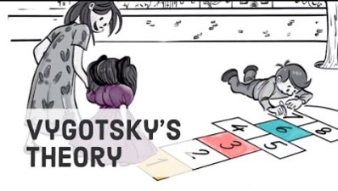
Video: A look at Vygotsky
https://youtu.be/8I2hrSRbmHE
Notes:
https://youtu.be/8I2hrSRbmHE

Slide 29
Activity
As a group, discuss how the concept of “proximal zone of development” can be used to inform IFSP/IEP planning

Slide 30
Attachment Theory

Slide 31
Harlow’s Experiments
Series of studies in the mid-1900’s
Young primates sought connection and comfort over food sources
Described the concept of early bonding in other animal species

Slide 32
Attachment and Regulation From an Adult Are Primary Needs
Babies are hard-wired to seek proximity to their mothers at birth
Through touch, rocking, singing, and caregiving, adults in virtually all cultures respond to the distress of infants and toddlers to restore them to a regulated state
Notes:
According to attachment theory, pioneered by Mary Ainsworth, Anna Freud, Melanie Klein, and other - babies are born hard-wired to seek proximity to their mothers, and immediately after birth use an array of behaviors (gazing, crying, rooting, grasping) to ensure that they are held, fed, and protected

Slide 33
Mary Ainsworth: Patterns of Attachment
Used the “Strange Situation” Paradigm
Recorded and validated attachment styles:
Secure
Insecure: Avoidant
Insecure: Resistant/Ambivalent
Insecure: Disorganized/Disoriented
Notes:
Mary Ainsworth, a pioneer in attachment theory, developed and validated specific patterns of attachment
Secure
Distressed when mother leaves; “happy reunion” when she returns
Caregiver perceived as reliable and loving; relationships tend to be mutual & caring
Insecure: Avoidant
Little distress when mother leaves; little reaction upon her return, doesn’t seek proximity
Caregiver perceived as unreliable, rejecting; relationships distant, preserving autonomy
Insecure: Resistant/Ambivalent
Intense distress when mother leaves; mixed reaction upon her return
Caregiver perceived as unreliable; relationships characterized by anxiety, approach-rejection
Insecure: Disorganized/Disoriented
May seem oblivious to other’s presence/absence, accept researcher as substitute, and/or engage in stereotyped, even bizarre behaviors
Ainsworth’s attachment work has been largely validated over the decades, that have since then been demonstrated to be relatively consistent across generations of parents and children
Ongoing data supports our understanding of how insecure attachment styles can influence the course of development over time
Including Developmental delays
Mental health disorders

Slide 34
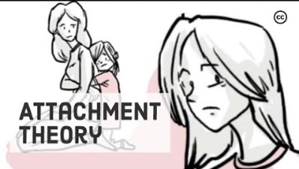
Video: A Look at Attachment Theory
https://youtu.be/WjOowWxOXCg
Notes:
Attachment theory shares a lot of overlap with Vygotskian theory and, as we will find out, with the Neuroscience of Early Childhood theoretical model, which we will explore next:
https://youtu.be/WjOowWxOXCg

Slide 35
Transactional/Ecological Theories
Merging behavioral, developmental and systems theory into a unified theory of child development

Slide 36
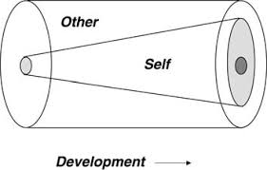
Transactional Model: Sameroff
Nature and nurture both influence development through a constant interactive process
Inborn and environmental forces shape development in a bi-directional and transactional manner
Notes:
Arnold Sameroff proposed the Transactional Model in the 1970’s. He believed that both nature and nurture are constantly being changed by their interaction with one another – and development is affected by both inborn and environmental forces that constantly shape the other. These forces occur at the family level and include effects of parental well being – or lack of well being – access to safety and basic resources - and also across environmental systems which include political forces, resources, community influences, including supports and threats to health and well being at a climate and global level.

Slide 37
Bronfenbrenner: Ecological Systems Theory
Importance of emotionally connected caregiving relationships – the need for safety and stability within families support emerging development
A dynamic system involving both the child’s biological makeup and the collective forces of environment to shape development
Notes:
Urie Bronfenbrenner (1917-2005) developed the Ecological Systems Theory
The Ecological systems theory shares many of the same ideas that Sameroff expressed. Both view the child as existing within an intricate system of variables, all of which could have an effect on their development.
Bronfenbrenner’s model uses a series of concentric circles to describe different systems that concurrently influence child development.
This model has provided us with one of the most comprehensive models of child development, offering a broad view of the complex variables and contexts active in the dynamic processes of human development.
Bronfenbrenner build his theory upon previous theories, acknowledging the central role of social interactions, the importance of emotionally connected caregiving relationships and the need for safety and stability within families to support emerging development.
Described a dynamic system involving both the child’s biological makeup and the collective forces of environment to shape development.
He called this the bio ecological model

Slide 38
Bioecological Model
Notes:
This model states that influences from a unified and related set of nested systems converge to shape the development of a child. What you see are concentric circles around a circle in the middle that represents the child.

Slide 39
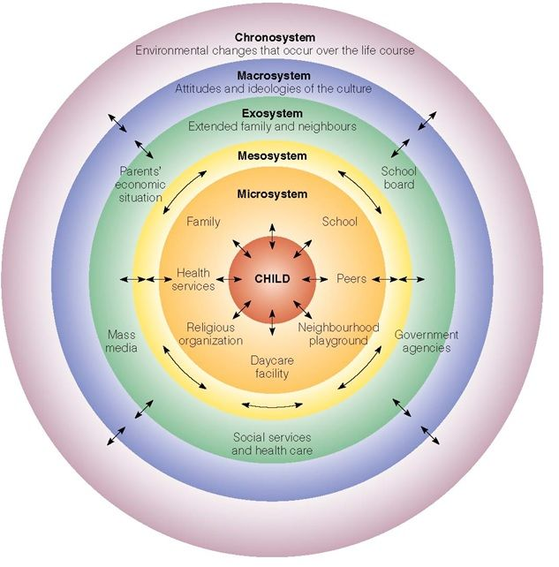
The Microsystem
Experiences and relationships at the level of the family environment, including home, neighborhood play areas, and childcare settings.
Bidirectional
Notes:
The first circle around the child is represents the microsystem Within the microsystem experiences and relationships at the level of the family environment, including home, neighborhood play areas, and childcare settings.
Interactions within all relationships are bidirectional

Slide 40
The Mesosystem
Contains connections between elements of the microsystems – home, neighborhood, childcare and recognizes the impact of each of these upon the other
Notes:
The circle that surrounds the child and the microsystem represents the mesosystem Contains connections between elements of the microsystems – home, neighborhood, childcare and recognizes the impact of each of these upon the other
For example, if a parent at home is coping with depression, positive interactions with the childcare staff may be reduced. Staff may in turn feel that the parent is not interested in the child’s well-being at school. The child, responding to the reality of having a parent who is coping with depression at home, may display disruptive behaviors at school as way of gaining adult connection, which may lead staff to blame the parent for the behavior of the child - and interact with the child in less positive ways.
Another example of influence at the level of mesosystem: if a child lives in a neighborhood where there are few resources for community activities, that child may have fewer connections to enriching interactions with others, and reduced access to other forms of information (books, cultural knowledge).

Slide 41
The Exosystem
Social settings outside of the child’s family structures but impact experiences
Formal support systems: religious, health care access, work-related benefits
Informal support systems: friends and extended family
Notes:
The next circle around these first 3 systems represents the exosystem Social settings that exist outside of the child’s family structures but nevertheless impact his experiences
Formal support systems like religious institutions, health care access, work-related benefits
Informal support systems like friends and extended family who provide emotional support, connection, and assistance when needed
Families who are isolated from these systems have fewer opportunities to empower themselves for self-protection and self-advocacy
More likely to be exposed to adversity and powerlessness

Slide 42
The Macrosystem
Larger constellation of culture, world views, laws, customs and collective resources
How leaders and systems prioritize the needs of children determine the experiences of children within the family
Notes:
The next circle around each of the other circles represents the Macrosystem Consists of the larger constellation of culture, world views, laws, customs and collective resources
How leaders and systems prioritize the needs of children in any given culture determine the experiences of children within the family
For example, some countries provide ample support and resources for childcare and parental leave for all, while others, including the US, do not routinely protect the needs of the child in the context of family.
Another example: children and families of immigrant families often do not have access to services that are typically provided at the national level

Slide 43
The Chronosystem
Environmental influences that shape the experience of an individual across the life span
Notes:
Finally, the widest circle around each of the inner circles represents the Chronosystem Environmental influences that shape the experience of an individual across the life span

Slide 44
Neuroscience of Early Childhood
Grounded in Sameroff’s Transactional Model and Ecological Systems theory, the neuroscience of early childhood model is situated in the context of multiple theoretical models
Notes:
Branded by Jack Shonkoff and his colleagues - and stewarded by the Harvard Center on the Developing Child.
Emerged over the past several decades, the science of early brain development has gained momentum in current practice and policy.
Grounded in both sociocultural interactive theory and ecological systems theory, the neuroscience of early childhood model is situated in many concepts you will recognize from previous child development theories – including attachment, social learning, and behavioral theories. What makes it unique is that the theoretical bases for development lies in the process of developing brain architecture.

Slide 45
Key Concepts: Neural Exuberance
Brains begin to develop from birth and develop at an astronomical pace in the first months of life
Over 1 million new connections per second
First years of life are when the foundations of brain architecture are formed
Notes:
through a lush proliferation of synaptic development in the first years – over 1 million new connections every second during this time – during a period of “neural exuberance”
Over 1 million new connections every second

Slide 46
Key Concepts: Serve and Return
Early experiences support or constrain brain architecture
Lay the foundation for all subsequent development
Early and consistent serve and return interactions optimize development for children of all abilities
Notes:
https://developingchild.harvard.edu/resources/serve-return-interaction-shapes-brain-circuitry/

Slide 47
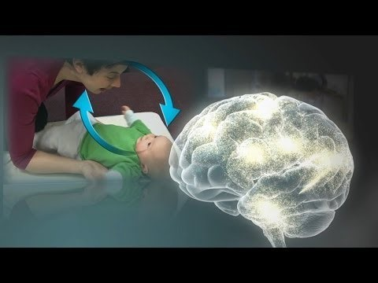
Video: Serve & Return Interaction Shapes Brain Circuitry
https://www.youtube.com/watch?v=m_5u8-QSh6A
Notes:
https://developingchild.harvard.edu/resources/serve-return-interaction-shapes-brain-circuitry/
https://www.youtube.com/watch?v=m_5u8-QSh6A

Slide 48
Key Concepts: Toxic Stress
Early and continuing adversity and/or trauma can derail developing brain architecture
Notes:
Facilitator can show the group this short video and discuss implications for children’s development
https://developingchild.harvard.edu/science/key-concepts/

Slide 49
Video: Toxic Stress Derails Healthy Development
https://www.youtube.com/watch?v=rVwFkcOZHJw
Notes:
https://www.youtube.com/watch?v=rVwFkcOZHJw
https://developingchild.harvard.edu/science/key-concepts/

Slide 50
Key Concepts: Resilience
Why do some children do well in the face of adversity, and others do not?
What determines how resilient a child is when faced with difficult circumstances?
Notes:
Resilience is a complicated capacity – informed by the unique biological capacities of the child in tandem with the protective (or harmful) impact of that child’s environment and primary relationships.
Over the past decade or so, science has demonstrated that predictable and responsive relationships are a powerful buffer against the negative effects of trauma.
Facilitator asks the group the questions on the slide.
Click on the link https://youtu.be/cqO7YoMsccU and then support discussion about how the theoretical underpinnings of resilience can be found in within the work of Sameroff, Bronfenbrenner and more recently, the Neuroscience of Early Childhood Development.
Note that behavioral theory is not at odds with the concepts of neuroscience and systems theory – behaviorists consider how extended experiences with reinforcing (positive and safe interactions with caregiving adults) and punishment contingencies set up ongoing antecedent conditions for behavior that may or may not serve the child well across settings. EI/ECSE providers must always be interested in the meaning of behavior as communication, and can support safety and developing resilience at home and at school within the context of best practices with young children.

Slide 51
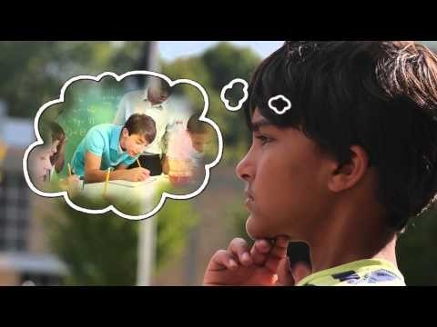
Video In Brief: What is Resilience?
https://youtu.be/cqO7YoMsccU
Notes:
https://youtu.be/cqO7YoMsccU

Slide 52
Group Activity I: Antonia and her family
Case-Study-Antonia-Family.Centered.Practice.pdf (ecpcta.org)
Notes:
Use the Antonia case history and the theoretical framework document of your assigned theory, discuss the following slide (slide 53): Case-Study-Antonia-Family.Centered.Practice.pdf (ecpcta.org) https://ecpcta.org/wp-content/uploads/sites/2810/2021/01/Case-Study-Antonia-Family.Centered.Practice.pdf

Slide 53
Framing Individual Theories
Using your assigned theoretical perspective, what would be the focus of your concerns for Antonia and her family?
What would your team want to explore about this case if you were all practitioners grounded in this theory?
Notes:
Facilitators will divide groups up between the behavioral, developmental, and transactional/ecological perspectives.
Use the discussion guide below to support the groups when they reconvene.
Behavioral Lens
Primary focus: Observable behaviors across settings – identifying specific goals for motor and communication skills. Interested in observing Antonia’s behaviors across routines - and planning for learning environments and instructional strategies that support social interaction, cognitive skills, and mobility. Observing and taking data for how Antonia’s family is supporting and reinforcing Antonia’s communication attempts both physically (positioning, adaptive supports) and socially (responding immediately and contingently to sounds, expressions, eye gaze). Finding out from the family what they need to increase family capacity to provide effective instructional and therapeutic support for Antonia across routines and settings.
Developmental Lens
Piaget
Primary focus: How is Antonia exploring her world through play? Is Antonia using her hands and mouth to explore toys that are placed in her hands? Is she currently reaching and grabbing toys to look at explore visually and with her hands? Is she using schemas like banging toys together, shaking them? Others? What sounds or gestures is she making as communication about her wants and needs? How is she playing in the presence of others – does she enjoy it when others join her in what she is attending to? Does she engage in cause-and effect actions like dropping toys while she is in her highchair? Does she imitate the expressions, sounds, or actions of others?
Attachment/Neuroscience of Early Childhood
Primary focus: Antonia’s primary relationships and what impacts them across generations, and the influence of early adversity. What were her early experiences when the family was experiencing ongoing housing difficulties, and when her father was living with active substance use? Was her mother, who had no other family support during that time, also preoccupied with the needs of keeping her family safe? Was she herself dealing with mental health challenges like depression? How might that have impacted the needs of a baby who may have learned that when she is quiet in her crib, her mother is calmer? How might the combination of minimal interactions and her developmental challenges combine to constrain her development? How might her need for safe, predictable and positive interactions have gone unmet during the time when there was a lot of change going on across 12 moves? What has changed since the family found more secure housing? Why is Antonia so often in her crib, and what will help this family engage her more often in positive interactions?
Vygotsky
Primary focus: Antonia’s interactions with family, and how her family teaches her about the world. How does this child interact with others, especially her family? Who talks to her, and who brings her out of her crib to engage and interact with others so that she can learn from her family? How does she interact with people outside the family, and how often? How will the Team engage this family to serve more fully as the more knowledgeable others? How will the team use the concept of Proximal Zone of Development to identify appropriate goals for Antonia?
Systems theory: Bronfenbrenner and Sameroff Lens
Primary focus: How is Antonia’s’ development influenced by reciprocal actions across all systems from family to the broader society? How does reality of the lack of stable housing and the father’s substance use impact Antonia’s well-being, including the need for a diagnosis and subsequent support for her developmental concerns? How might the fact that family housing is unstable in turn impact how the family is able to engage in services for Antonia? How would the team want to work to make sure housing, physical and mental health care, and appropriate therapeutic services are accessible so that in turn, the family is empowered to help Antonia be fully included in family interactions – and be supported to practice new targeted skills as she grows?

Slide 54
References and Resources
Ainsworth, M. D. S. (1978). The Bowlby-Ainsworth attachment theory. Behavioral and brain sciences, 1(3), 436-438.
Berk, L.E., (2019). Exploring Child Development. Pearson.
Bronfenbrenner, U. (1992). Ecological systems theory. Jessica Kingsley Publishers.

Slide 55
References and Resources
Early Childhood Personnel Center (ECPC): Cross-Disciplinary Competencies
Harvard Center on the Developing Child: https://developingchild.harvard.edu/resources/inbrief-the-science-of-early-childhood-development/
Sameroff, A. (2010). A unified theory of development: A dialectic integration of nature and nurture. Child development, 81(1), 6-22.
Notes:
https://ecpcta.org/
https://ecpcta.org/cross-disciplinary-competencies/
https://srcd.onlinelibrary.wiley.com/doi/10.1111/j.1467-8624.2009.01378.x

Slide 56
References and Resources
Shepley, C., & Grisham-Brown, J. (2019). Applied behavior analysis in early childhood education: An overview of policies, research, blended practices, and the curriculum framework. Behavior analysis in practice, 12(1), 235-246.
Notes:
https://www.ncbi.nlm.nih.gov/pmc/articles/PMC6411562/pdf/40617_2018_Article_236.pdf

Slide 57
Disclaimer

