Slide 1

Comprehensive System of Personnel Development (CSPD) Workgroup Orientation
www.ecpcta.org
Notes:
Add State, date and names of ECPC staff.

Slide 2
Agenda
Introductions
Comprehensive System of Personnel Development (CSPD) Overview
Review CSPD Work
CSPD Subcomponent Workgroups
Develop Action Plans for Each CSPD Subcomponent Workgroup
Subcomponent Workgroup Sharing
Wrap Up/Evaluations/Next Steps
Notes:
Add state specific agenda

Slide 3
State Vision Statement
State Mission Statement
Notes:
Add State Vision and Mission Statement to this slide

Slide 4
Early Childhood Personnel Center
Purpose:
to facilitate the implementation of
comprehensive systems
of personnel development (CSPD)
for all disciplines
serving infants and young children
with disabilities and their families

Slide 5
Introduction to the CSPD Components
Recruitment and Retention
Strategies to identify, hire and maintain a qualified workforce across sectors and discipline
Inservice Training
Ongoing learning activities to maintain and build the competence of the EC workforce
Leadership, Coordination & Sustainability
Structures for ongoing support of all personnel development activities
Personnel Standards
Discipline specific knowledge, skills and competencies for the EC workforce
Preservice Training
Formal program of study at an IHE to prepare for the EC workforce
Evaluation
Plans for evaluating each subcomponent of the CSPD
https://ecpcta.org/cspd/
Notes:
Go to the https://ecpcta.org/cspd/

Slide 6
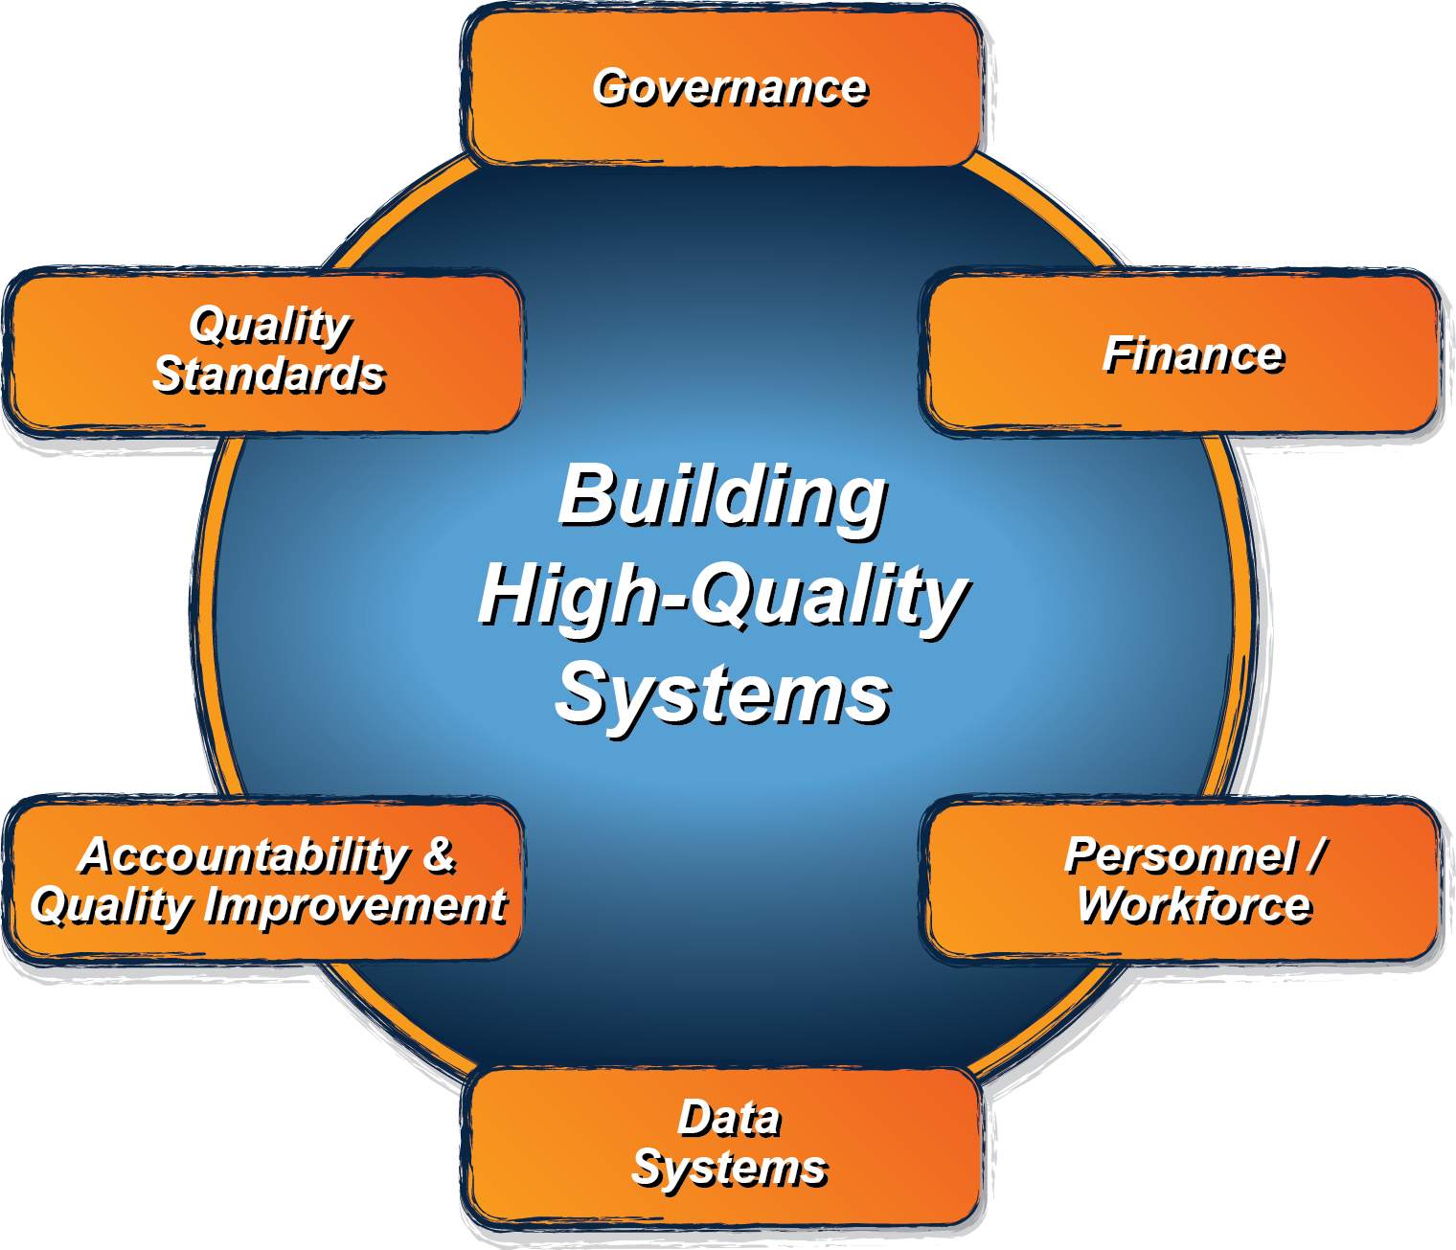
Early Childhood Systems Framework
http://ectacenter.org/sysframe/
Notes:
Remind the states that the Personnel/Workforce is a component of the Early Childhood Systems Framework

Slide 7
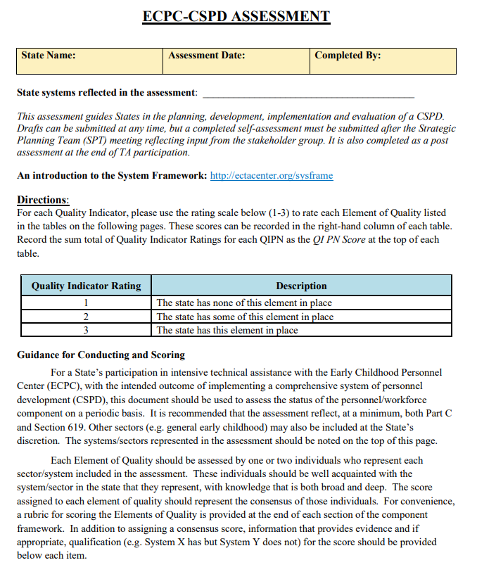
Link to Self-Assessment
Notes:
Sample page of the ECPC-CSPD Self Assessment

Slide 8
A Comprehensive System of Personnel Development (CSPD)
Addresses the following challenges:
  Shortages of personnel
  Need for additional training at both the preservice and inservice levels
  Inconsistent alignment of state and national competencies and standards
  Challenges faced by EC personnel due to the diverse needs and young children and their families
  Inequities of preparation and compensation among those providing services

Slide 9
An Effective Comprehensive System of Personnel Development (CSPD)
Coordinates and addresses state needs for quantity and quality of EC personnel and their degree of support required
Acknowledges the coordination between pre- and in-service personnel development (PD) to ensure consistency of practice
Stays informed through ongoing evaluation via multiple sources and monitors the results and capacity to implement child and program quality standards

Slide 10
Why do we need a CSPD?
A CSPD is the primary mechanism by which a state ensures that infants, toddlers, and young children with disabilities and their families are provided services by knowledgeable, skilled, competent, and highly qualified personnel, and that sufficient numbers of these personnel are available in the state to meet service needs.
An effective CSPD is key to promoting both effective practices and the implementation of legal requirements as determined by the IDEA.

Slide 11








If we want improved outcomes for infants and young children with disabilities and their families, then…….
Theory of Action
ECPC’s
focus
More EC leaders and practitioners have the requisite knowledge and skills
Improved effectiveness of EI, ECSE, and
EC services and supports
Improved outcomes for children and families
States have high quality CSPD
Note: The working assumption is that the blue box will produce the green boxes. Large scale change will occur after the 5 years of the Center.

Slide 12
Qualified Personnel Identified in IDEA
Part C (ages 0-3)
Part B - 619 (ages 3-5)
Audiologists
Family therapists
Nurses
Occupational therapists
Orientation and mobility specialists
Pediatricians and other physicians for diagnostic and evaluation purposes
Physical therapists
Psychologists
Registered dieticians
Social workers
Special educators, including teachers of children with hearing impairments (including deafness) and teachers of children with visual impairments (including blindness).
Speech and language pathologists.
Vision specialists, including ophthalmologists and optometrists.
Other
Special Education;
Related Service Personnel:
  Speech-Language Pathologists and Audiologists;
  Occupational Therapists;
  Psychologists;
  Physical Therapists;
  Recreational Therapists;
  Social Workers;
  Counseling services;
  Orientation and Mobility Specialists, and
  Pediatricians and other Physicians, except that such medical services shall be for diagnostic and evaluation purposes only
Notes:
Optional - reformat the slide #a
I am really not sure that you need to include this slide.
Part C– directly out of the law.
(1) Audiologists.
(2) Family therapists.
(3) Nurses.
(4) Occupational therapists.
(5) Orientation and mobility specialists.
(6) Pediatricians and other physicians for diagnostic and evaluation purposes.
(7) Physical therapists.
(8) Psychologists.
(9) Registered dieticians.
(10) Social workers.
(11) Special educators, including teachers of children with hearing impairments (including deafness) and teachers of children with visual impairments (including blindness).
(12) Speech and language pathologists.
(13) Vision specialists, including ophthalmologists and optometrists.
Part B/619
Autism
Deaf-blindness
Deafness
Emotional disturbance
Hearing impairment
Intellectual disability
Multiple disabilities
Orthopedic impairment
Other health impairment (including ADHD)
Specific learning disability (including dyslexia, dyscalculia and dysgraphia, and other learning issues)
Speech or language impairment
Traumatic brain injury
Visual impairment, including blindness
However, having one of the 13 disabilities doesn’t automatically qualify a child under IDEA. To be eligible, a student must:
Have a disability and, as a result of that disability…
Need special education in order to make progress in school

Slide 13
Comprehensive System of Personnel Development
Recruitment and Retention
Strategies to identify, hire and maintain a qualified workforce across sectors and discipline
Inservice Training
Ongoing learning activities to maintain and build the competence of the EC workforce
Leadership, Coordination & Sustainability
Structures for ongoing support of all personnel development activities
Personnel Standards
Discipline specific knowledge, skills and competencies for the EC workforce
Preservice Training
Formal program of study at an IHE to prepare for the EC workforce
Evaluation
Plans for evaluating each subcomponent of the CSPD

Slide 14
Building A CSPD
Personnel Framework
Strategic Planning with Stakeholders
CSPD
Plan and On-Going Committees

Slide 15
Comprehensive System of Personnel Development
Leadership, Coordination, & Sustainability | Quality Indicator 1: A cross sector leadership team is in place that can set priorities and make policy, governance, and financial decisions. Quality Indicator 2: There is a written multi-year plan in place to address all sub-components of the CSPD.
Recruitment and Retention | Quality Indicator 3: Comprehensive recruitment and retention strategies are based on multiple data sources and revised, as necessary. Quality Indicator 4: Comprehensive recruitment and retention strategies are being implemented across disciplines.
State Personnel Standards | Quality Indicator 5: State personnel standards across disciplines are aligned to national professional organization personnel standards. Quality Indicator 6: The criteria for state certification, licensure, credentialing and/or endorsement are aligned to state personnel standards and national professional organization personnel standards across disciplines.
Pre-service Personnel Development | Quality Indicator 7: Institution of higher education (IHE) programs and curricula across disciplines are aligned with both national professional organization personnel standards and state personnel standards. Quality Indicator 8: Institution of higher education programs and curricula address early childhood development and discipline specific pedagogy.
In-service Personnel Development | Quality Indicator 9: A statewide system for in-service personnel development and technical assistance is in place for personnel across disciplines Quality Indicator 10: A statewide system for in-service personnel development and technical assistance is aligned and coordinated with higher education program and curricula across disciplines
Evaluation of the System | Quality Indicator 11: The evaluation plan for the CSPD includes processes and mechanisms to collect, store, and analyze data across all subcomponents Quality Indicator 12: The evaluation plan is implemented, continuously monitored, and revised as necessary based on multiple data sources

Slide 16
PHASE ONE
Exploration
PHASE TWO
Installation
Identify a date and location for strategic planning meeting
Invite stakeholders to be part of strategic CSPD team
PHASE THREE
Implementation
Facilitate a 1-2-day meeting to develop the state CSPD vision, mission, and plans for work groups for each subcomponent of the CSPD
Establish meeting and reporting schedule for work groups and large strategic planning team
PHASE FOUR
Standardization
Identify stakeholders for strategic planning team
Develop core planning team and project liaison
Complete the readiness tool for ECPC; the TA tracking tool and the self-assessment of the CSPD framework
Decide if ECPC intensive TA is a match for state needs
Implement work plans for each CSPD subcomponent workgroup
Meet monthly as a core planning team to review work group progress and give feedback and assistance
Meet with the CSPD strategic planning team quarterly to review progress and adjust work plans
Prepare integrated CSPD report of process and implementation plan
Implement all subcomponent activities
Evaluate all CSPD activities and modify as needed
Revise CSPD and plan for sustainability
Develop monthly reports on each CSPD workgroup’s progress, to distribute across all groups
PHASE Two: months 5-6
PHASE Three: months 7-17
PHASE Four: month 18 and ongoing
PHASE One: months 1-4

Slide 17
Work Plan for Each Sub-component
Sub-Component State: Date Developed:
Goals/Objectives Activities | Person(s) Responsible | Resources Needed | Timelines | Criteria for Success
GOAL 1.
Objective 1.1
Activity 1.1.1.
Objective 1.2.
GOAL 2.
Objective 2.1.
Objective 2.2
Objective 2.3.
GOAL 3.
Objective 3.1
Objective 3.2
Objective 3.3

Slide 18
Core Planning Team (CPT)
6-8 Members
Representatives (not limited to)
  State Part C Coordinator
  State 619 Coordinator
  Parent
  Higher Education
  Child Care
  Professional Development
Responsibilities
  Obtain agency leadership approval
  Establish SPT and workgroups
  Information gathering and sharing with SPT
  Create vision and mission
  Oversee CSPD development, implementation, evaluation

Slide 19
Strategic Planning Team (SPT)
20-25 Members
Representatives
  Parents
  Higher Ed
  In-service
  Licensure
  Local administrators
  Data managers
  Direct service providers
  Other stakeholders
Responsibilities
  Provide information on current status
  Provide feedback on proposed initiatives and changes

Slide 20
Subcomponent Workgroups
4-6 Members
Representatives
  Parents
  Higher Ed
  In-service
  Licensure
  Local administrators
  Data managers
  Direct service providers
  Other stakeholders
Responsibilities
  Data collection
  Develop action plan
  Implement action plans

Slide 21
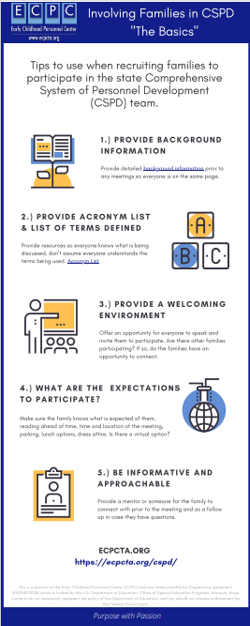
Link to infographic

Slide 22
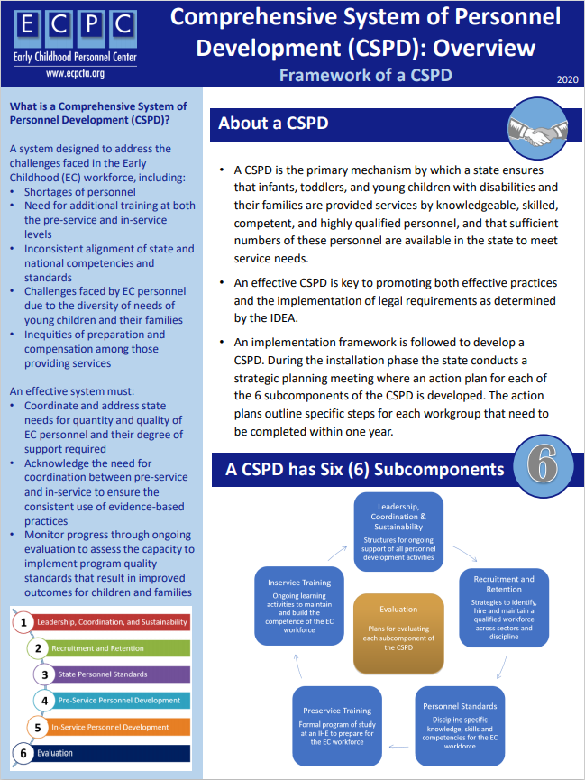
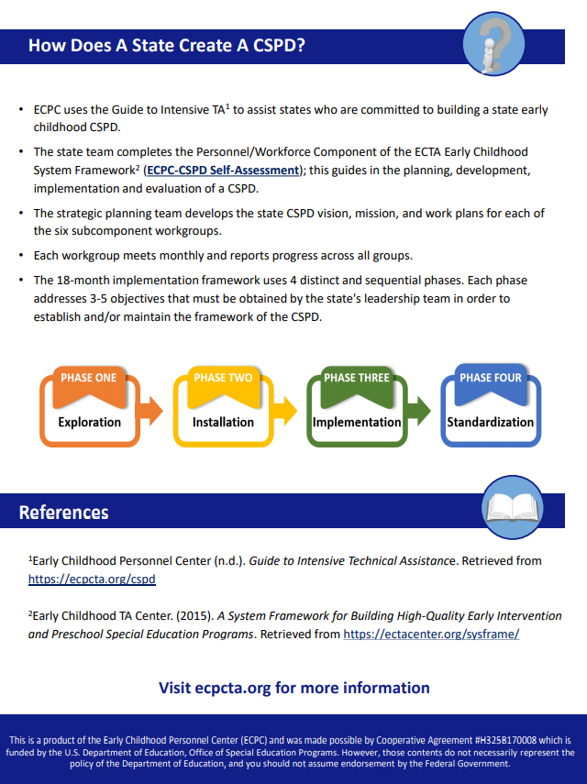

Slide 23
CSPD Subcomponent
Leadership, Coordination, and Sustainability
Addresses the membership and responsibilities of a leadership team and the required elements of a written plan for the CSPD sustainability.
Includes:
  representatives with in-depth knowledge, authority, and influence for each of the service sectors (e.g., early childhood education, Part C, and Section 619) represented in the system
  important stakeholders, including families whose children receive services, direct service program administrators, educators and trainers who prepare personnel,
  personnel who provide services
Functions of the leadership team include advocating for resources; making decisions and setting priorities for personnel development; keeping stakeholders informed; soliciting feedback from stakeholders; being aware of related and tangential state initiatives in early childhood; and monitoring the functionality, effectiveness, and efficiency of the CSPD.
The written plan delineates responsibilities, procedures, and processes for all subcomponents of the CSPD.

Slide 24
Leadership, Coordination, and Sustainability
Quality Indicator 1: A cross sector leadership team is in place that can set priorities and make policy, governance, and financial decisions.
Quality Indicator 2: There is a written multi-year plan in place to address all sub-components of the CSPD.

Slide 25
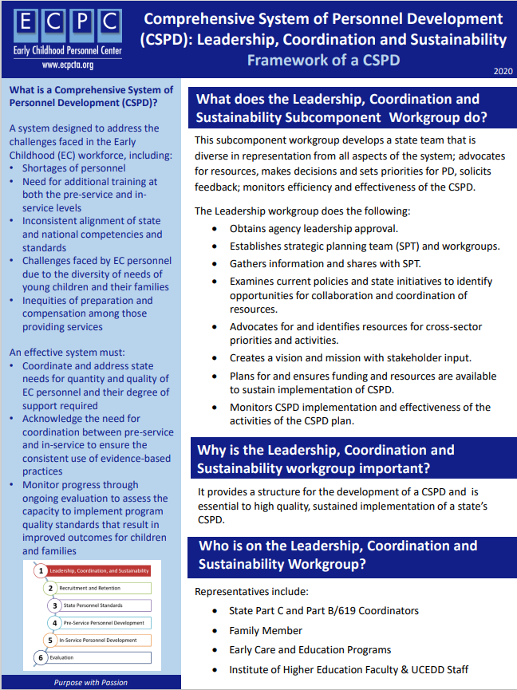
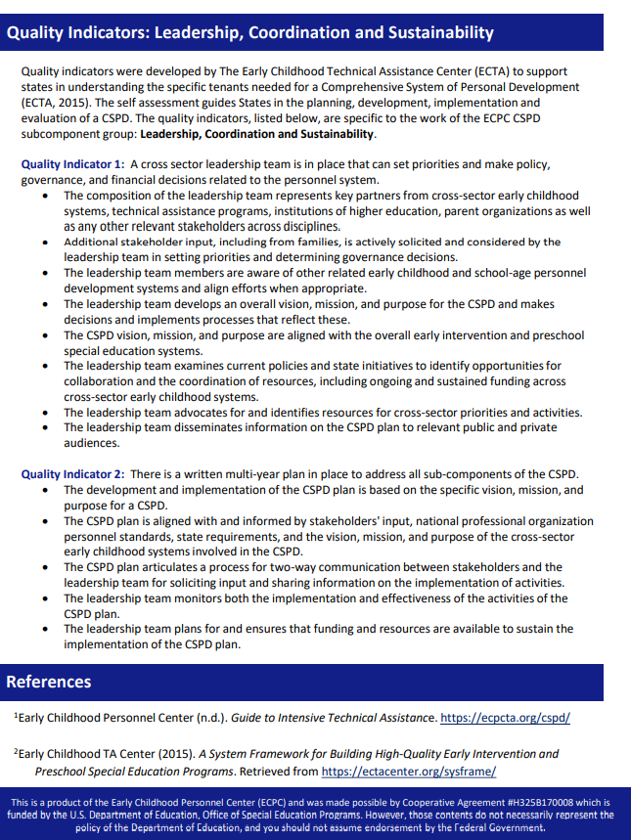

Slide 26
CSPD Subcomponent
Recruitment and Retention
Addresses the need to ensure that positions are filled by individuals who meet state and national qualifications to provide early childhood intervention (EI/ECSE).
Information related to anticipated vacancies or a need for increased personnel is necessary to meet the needs of IDEA eligible infants and young children.

Slide 27
Recruitment and Retention
Quality Indicator 9: Comprehensive recruitment and retention strategies are based on multiple data sources and revised as necessary.
Quality Indicator 10: Comprehensive recruitment and retention strategies are being implemented across disciplines.

Slide 28
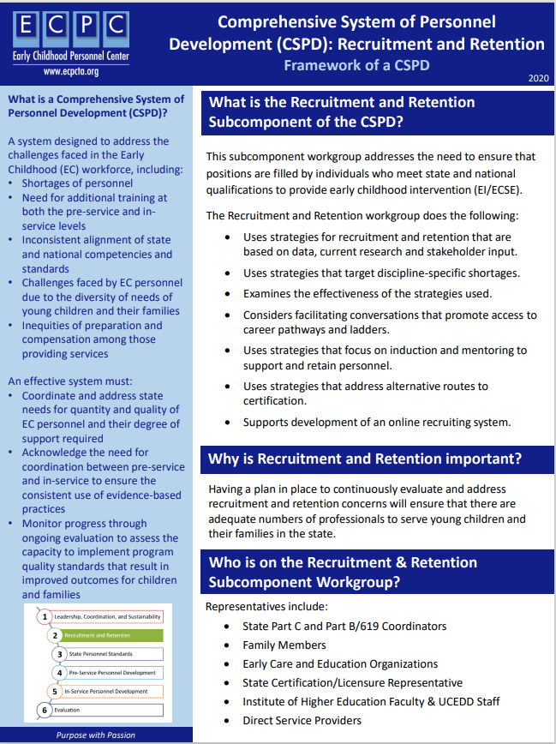
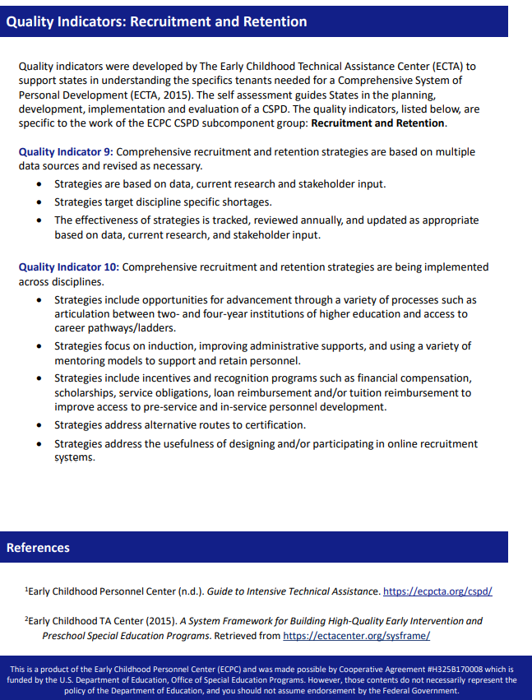

Slide 29
CSPD Subcomponent
Personnel Standards
Addresses the need to establish and maintain standards that define the knowledge, skills, and competencies of the early childhood intervention workforce.
State standards
  are credentials, certifications or licenses awarded to professionals after they complete a course of study that prepares them to provide intervention services as one of the disciplines recognized under IDEA.
  should meet or exceed personnel standards that have been developed by national organizations that represent the various professional disciplines that provide services to young children and their families.
  ensure the quality of the state early childhood workforce.

Slide 30
State Personnel Standards
Quality Indicator 3: State personnel standards across disciplines are aligned to national professional organization personnel standards.
Quality Indicator 4: The criteria for state certification, licensure, credentialing and/or endorsement are aligned to state personnel standards and national professional organization personnel standards across disciplines

Slide 31
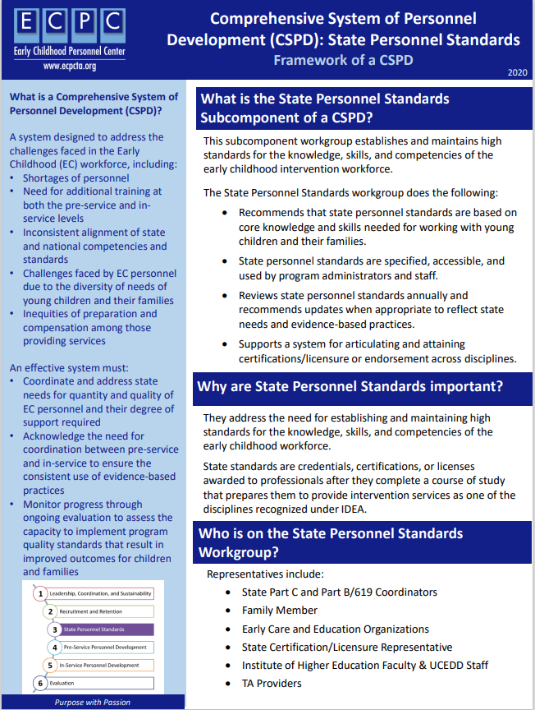
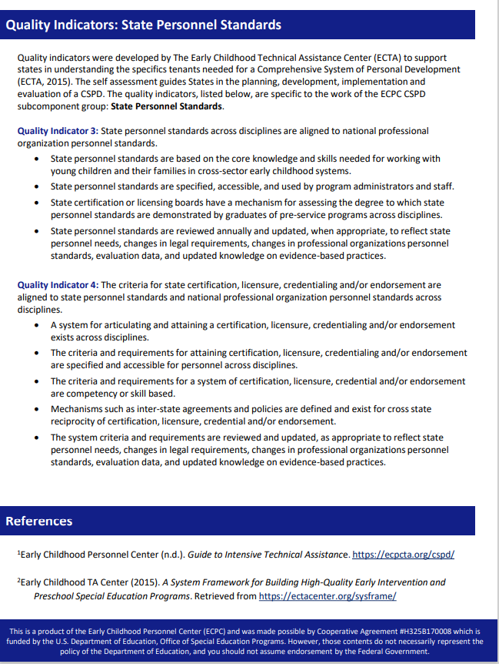

Slide 32
CSPD Subcomponent
Pre-Service
Pre-service is the term used to describe the education and training that occurs prior to a practitioner obtaining a college degree and entering the workforce.
Pre-service prepares individuals to meet the personnel standards of a specific discipline.
Institutes of Higher Education (IHE) programs of study provide training for individuals to acquire the specified knowledge, skills, and competencies required to meet state and national personnel standards in a specific discipline. The programs of study also include sufficient field-based experiences across a variety of high-quality infant and early childhood settings

Slide 33
Pre-Service Personnel Preparation
Quality Indicator 5: Institution of higher education (IHE) programs and curricula across disciplines are aligned with both national professional organization personnel standards and state personnel standards.
Quality Indicator 6: Institution of higher education programs and curricula address early childhood development and discipline specific pedagogy.

Slide 34
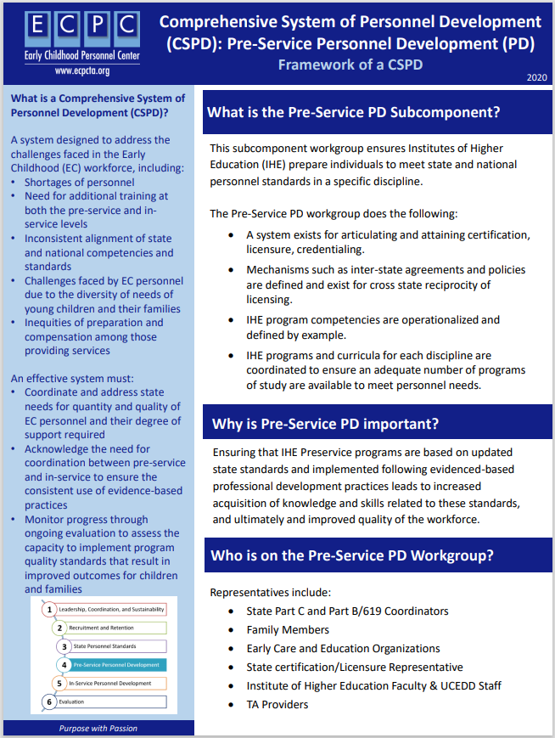
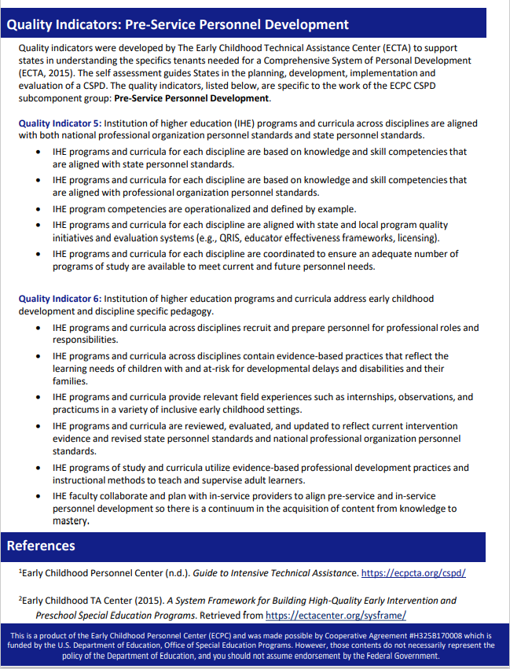

Slide 35
CSPD Subcomponent In-service
In-service refers to on-going training for practitioners to maintain and extend existing skills, and to acquire new knowledge and skills.
States need to be knowledgeable about the training needs of the existing workforce, and to plan for the provision of in-service professional development.
In-service training should include a focus on evidence-based intervention practices (EBP), knowledge and skill competencies specified in personnel standards, and implement training in accordance with adult learning principles.

Slide 36
In Service Personnel Preparation
Quality Indicator 7: A statewide system for in-service personnel development and technical assistance is in place for personnel across disciplines.
Quality Indicator 8: A statewide system for in-service personnel development and technical assistance is aligned and coordinated with higher education program and curricula across disciplines.

Slide 37
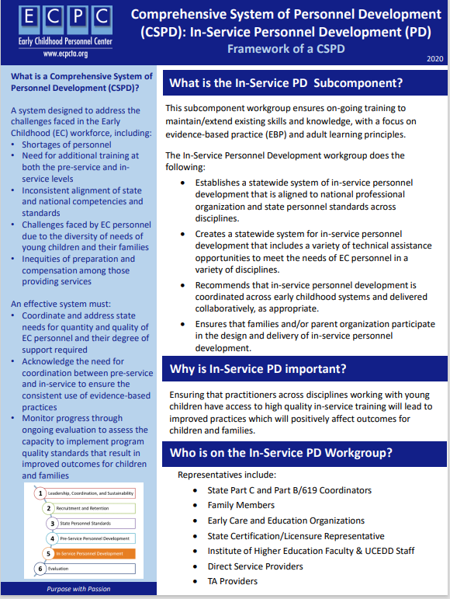
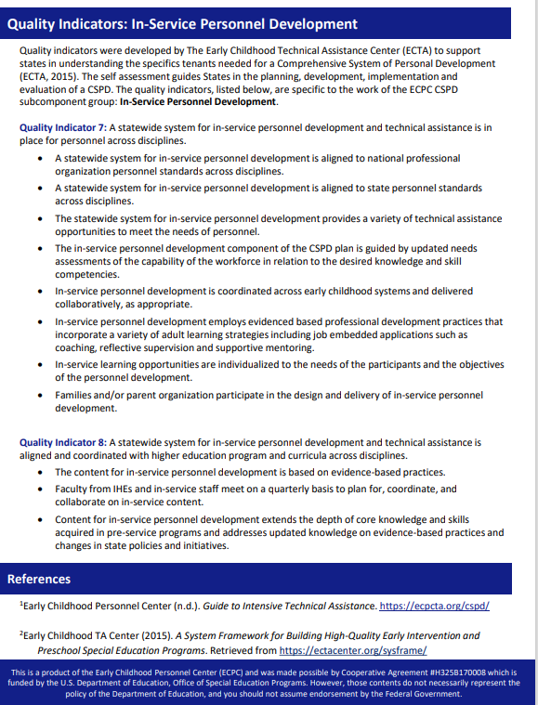

Slide 38
CSPD Subcomponent Evaluation of the System (Evaluation Plan)
Addresses each subcomponent of the CSPD and, initially, address the most critical features of each.
Evaluation should be viewed as cyclical in nature. That is, evaluation questions are generated, data are collected, data are analyzed and used to make decisions about the system, changes to the system are made based on the data, system changes are evaluated, and new evaluation questions are generated.

Slide 39
Evaluation of the System
Quality Indicator 11: The evaluation plan for the CSPD includes processes and mechanisms to collect, store, and analyze data across all subcomponents.
Quality Indicator 12: The evaluation plan is implemented, continuously monitored, and revised as necessary based on multiple data sources.

Slide 40
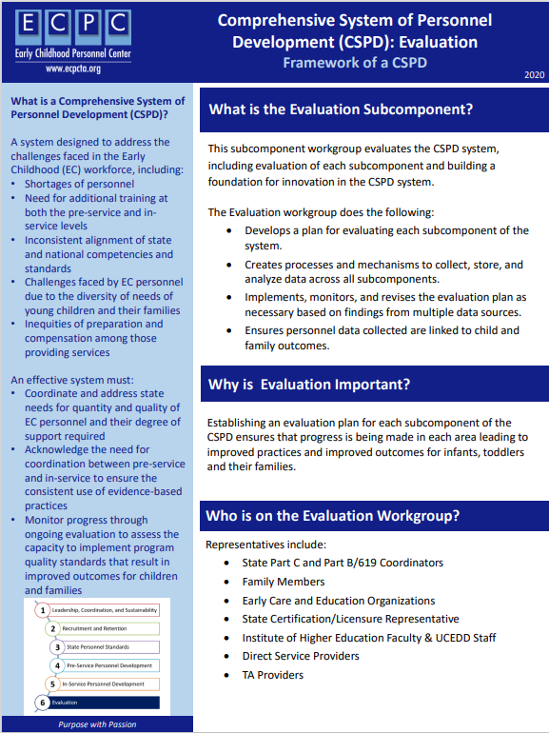
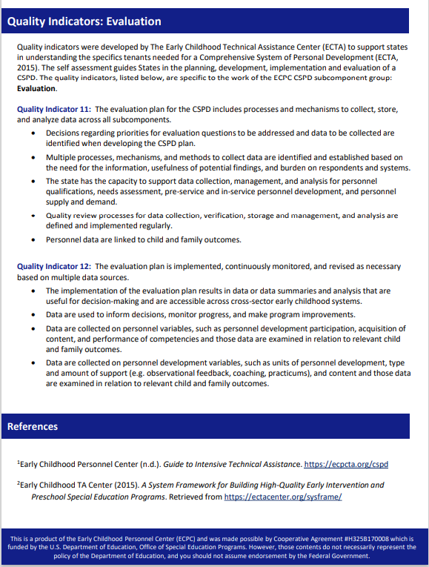

Slide 41
What is an Action Plan?
An action plan is a document that outlines specific steps that need to be completed for the group to accomplish its mission and/or vision. Action plans should include the following information:
Goal(s), objective(s), and action steps
Target initiation date and deadlines for each action step
Evaluation
Each action plan should be achievable in one year.
Person responsible for each action step
Progress notes

Slide 42
An action plan should include:
  Clear statement of the problem the strategic plan intends to address
  Broad goal statement of what to be accomplished
  Outcome-oriented objectives which move toward that accomplishment
  Strategies and actions which will enable the accomplishment of objectives
  Operational guidelines for implementation

Slide 43
Start with a Smart Goal
S
Specific
M
Measurable
A
Achievable
R
Relevant
T
Time-bound

Slide 44
Work Plan for Each Sub-component
Sub-Component State: Date Developed:
Goals/Objectives Activities | Person(s) Responsible | Resources Needed | Timelines | Criteria for Success
GOAL 1.
Objective 1.1
Activity 1.1.1.
Objective 1.2.
GOAL 2.
Objective 2.1.
Objective 2.2
Objective 2.3.
GOAL 3.
Objective 3.1
Objective 3.2
Objective 3.3

Slide 45
Directions: Place a check in the corresponding box to evaluate the quality of your action plan.
Criteria | Yes | No | Future Considerations
Goal(s): The goal(s) in the plan target a component of the CSPD for Early Childhood Intervention | ☐ | ☐
Objectives: Objectives in the plan are directly related to a goal (e.g., alignment of personnel standards) | ☐ | ☐
Activities: Activities in the plan are directly related to an objective (e.g., survey IHE programs) | ☐ | ☐
Sequence: Each objective and activity are logically sequenced for achievement of a goal | ☐ | ☐
Criteria: Each objective and activity include clear and measurable criteria for achievement | ☐ | ☐
Timelines for Completion: Each objective and activity includes a measurable timeline for milestones, data collection, completion and achievement | ☐ | ☐
Resources Needed: Each objective and activity includes a description and list of resources needed for meeting criteria, timelines and achievement | ☐ | ☐
Person(s) Responsible: Each objective and activity includes a designated person or group who will be responsible for completing the objective and/or the activity | ☐ | ☐
Progress Monitoring: Each objective and activity includes a schedule for progress monitoring of benchmarks and outputs to facilitate the revision of the action plan (as necessary) | ☐ | ☐
Evaluation: Each goal (s) on the action plan will have a data collection schedule to document, measure, and analyze all outputs and results/outcomes | ☐ | ☐

Slide 46
Elements of Change
Where are we now?
Where do we want to be?
What do we need to do to get from here to there?

Slide 47
Next Steps

