Slide 1
Early Childhood Inclusion:
Module 3
Specialized Instruction

Slide 2
Early Childhood Inclusion
Introduction to Early Childhood Inclusion
The Early Childhood Environment
Specialized Instruction
Importance of Collaboration
The Future of Inclusion
Notes:
Now let’s turn to looking at the Specialized Instruction or Special Education service that is required when ensuring an inclusive education.

Slide 3
Specialized Instruction
Topics
Specially Designed Instruction
Identifying Target Skills
Identifying Instructional Practices
Embedded Instruction
Implementation Fidelity
Progress Monitoring
Notes:
We will start by discussing the Specially Designed Instruction or specialized instruction and what it means. We will then discuss target skills, instructional practices, embedding instruction, as well as what it means to implement practices with fidelity, and the importance of progress monitoring.

Slide 4
Is access to a high-quality early childhood program enough?
If young children with disabilities are to enter kindergarten with the early readiness skills that serve as the foundation for all learning, they not only need access to a high-quality early childhood program, but they must receive the necessary specially designed instruction or specialized instruction (special education and related services) to meet high expectations.
Notes:
Children with disabilities require BOTH access to a high-quality general education setting and specialized instruction designed to meet their individual needs.

Slide 5
Individuals with Disabilities Education Act (IDEA)- Services for Children with Disabilities
0-3 Years Old
3-5 Years Old
Early Intervention (EI)
Early Childhood Special Education (ECSE)
Notes:
Let’s discuss Part C and Part B of the Individuals with Disabilities Education Act (IDEA). Part C is the part that covers Early Intervention services for infants and toddlers between birth and 3 years old, and Part B, section 619, covers Early Childhood Special Education (ECSE) for preschoolers between 3-5 years old. ECSE is simply a subsection of the larger Part B which covers children with disabilities between 3-21 years of age.

Slide 6
Early Intervention (IDEA-Part C)
Provides support to families with infants and toddlers who have developmental disabilities or delays, so they can help their children develop to their fullest potential.
Infants and Toddlers learn best:
  From their preferred adults,
  In places that are familiar and comfortable, and
  When they have multiple opportunities to practice skills throughout their daily routine.
Most Early Intervention services are provided in the natural environment through a family coaching model, NOT a medical/therapeutic model.
Notes:
What is Early Intervention?

Slide 7
Special Education (IDEA- Part B)
Ensures that all children with disabilities have available to them a free and appropriate education (FAPE) with services designed to meet their unique needs and prepare them for further education, employment and independent living.
Special Education:
  Is not a place.
  It refers to specially designed instruction (adapting the content, methodology, or delivery of instruction).
  Ensures access to the general education curriculum so that each child with a disability can meet the educational standards that apply to all children.
Notes:
What is Special Education?

Slide 8
Special Education & Related Services
To witness the desired results, including a sense of belonging and membership, positive social relationships and friendships, and development and learning to reach their full potential, children with disabilities must receive the necessary and individualized special education and related services for which they are eligible.
Early Childhood Inclusion: A Summary (naeyc.org)
Notes:
In their joint position statement, the Division for Early Childhood (DEC) of the Council for Exception Children (CEC), in partnership with the National Association for the Education of Young Children (NAEYC), speaks to the importance of individualized special education and related services if children with disabilities are to witness the desired results of an inclusive education.

Slide 9
Special Education Eligibility
A child is determined eligible for special education after a comprehensive evaluation if the child meets the criteria for one of the eligibility categories and who, by reason thereof, requires special education and related services.
By determining a child eligible for special education, the team confirms that the child requires special education (specialized instruction) and related services to benefit from their education.
Notes:
Let’s look at what the determination of special education eligibility involves.

Slide 10
Special Education Services within the General EC Environment
The first consideration should always be the provision of early intervention or special education within the natural environment or the environment a child would participate if not for their disability.
EI/ECSE
Home
Private Childcare
State PreK
Family Childcare
Early Head Start & Head Start
Notes:
So where can EI/ECSE be provided?

Slide 11
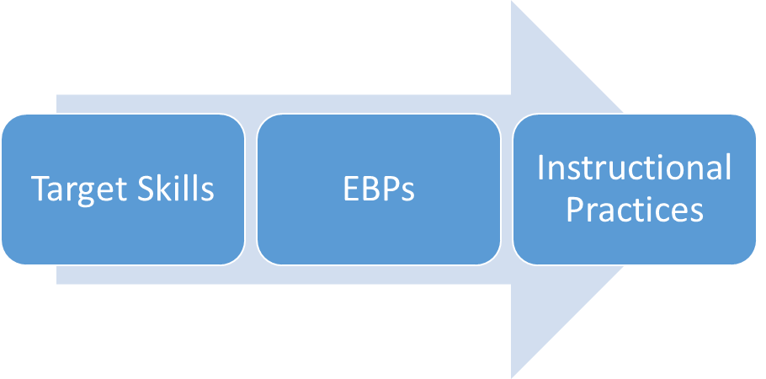
Process for Determining Specially Designed Instruction
The first step in determining the necessary specially designed instruction is to identify the individual child’s target skills.
Notes:
Let’s now transition to the discussion of determining the specific specially designed instruction a child will need to be successfully included in the general education classroom.

Slide 12
Target Skills
Target skills are the specific skills a child needs to develop to successfully participate in the EC classroom.
Target skills are identified based on observation of a child’s functioning in classroom activities, routines, and transitions & through collaboration with the EC teacher and parent.
Consideration must be given to the Early Learning Standards and what children are expected to know and be able to do.
Notes:
What does the term target skills mean, and how are they identified?

Slide 13
Prioritizing Target Skills
It is important to prioritize each child’s target skills to identify:
  The most critical skills for each child’s active and successful engagement in classroom learning activities
  The skills that require specially designed instruction, as not all skills require specialized instruction. Some skills are learned through maturation, the environment, or peers
*It is important to identify the target skill that will require specialized instruction and the target skills the child will likely learn incidentally through maturation, environmental modification, or peer interaction (MEPI).
  A Guide to Itinerant Early Childhood Special Education Services (brookespublishing.com)
Notes:
Dr. Laurie Dinnebeil and Dr. Bill McInerney speak to the importance of prioritizing target skills in their book, A Guide to Itinerant Early Childhood Special Education Services

Slide 14
EBPs & Instructional Practices
Once specific target skills are identified, special educators must determine evidence-based and instructional practices.
“Evidence-based practice in the field of early childhood is the process that pulls together the best available research, knowledge from professional experts, and data and input from children and their caregivers, to identify and provide services, evaluated and proven to achieve positive outcomes for children and families.”
ECTA Center: Evidence-Based Practice
“When teachers of young children identify specific behaviors or skills they want a child to learn, they can use systematic instruction practices to teach those targeted skills. By carefully planning and intentionally using teacher-directed instruction strategies, teachers can help a child learn new behavior, continue to use the behavior over time, and use the behavior in different activities and with different people.”
PG_Ins_SystematicInstr_prac_print_2017.pdf (ectacenter.org)
Notes:
After target skills have been identified, the ECSE teacher must consider how the child will learn these important skills. This is one place where their special educational experience and expertise are critical.

Slide 15
Instructional Practices
Instructional practices must:
  Be planned and intentional.
  Be delivered with fidelity.
  Make use of verbal, gestural, physical, or other kinds of prompts and prompt fading techniques.
  Use different behavior elaboration strategies (modeling, providing choices, asking questions, expansions, etc.).
  Provide multiple learning opportunities across different activities, with different people, and across materials to promote not only the acquisition of the target skill but also maintenance and generalization.
Systematic Instructional Practices Checklist (ectacenter.org)
Notes:
Click on the link to see the important considerations when determining and implementing instructional practices.

Slide 16
Embedded Instruction
Embedded instruction can be used to facilitate the acquisition of target skills by providing opportunities for learning embedded into everyday early childhood classroom activities and routines.
Identify the everyday class routine.
Determine multiple activities and routines that best lend themselves to teaching each target skill.
Consider the child’s interests and preferences.
Provide context-specific natural reinforcement for a child’s use of target skills or attempts to produce the behavior.
Embedded Instructional Practices Checklist (ectacenter.org)
Notes:
The importance of embedding instruction into everyday routines can not be overstated. The checklist will provide additional information to consider when embedding instruction.

Slide 17
Embedding Instructional Practices in Everyday Routines & Activities
Children learn best when they’re interested and motivated and when multiple opportunities to learn and practice occur naturally throughout the day.
Determine the daily routines and activities that best lend themselves to learning each target skill and provide an opportunity to embed the instructional practices.
Notes:
Can you give an example of something you have learned when it has been embedded into your daily routine as opposed to being taught in isolation?

Slide 18
Embedding Instructional Practices in Everyday Routines & Activities - example
A simple way to identify these learning opportunities is by using a planning matrix.
A planning matrix is simply a matrix with the daily schedule written down the left-hand column and the target skills written across the top.
The instructional practices are then embedded into the matrix as determined.
 | Target Skill #1 | Target Skill #2 | Target Skill #3 | Target Skill #4
Arrival
Breakfast
Centers
Group
Outdoors
Lunch
Nap
Centers
Story
Dismissal
Notes:
Let’s look at how a Planning Matrix can be used to identify the learning opportunities embedded throughout the daily routine.

Slide 19
The Planning Matrix
Each child should have a single planning matrix that includes all of the ECSE teacher and therapists’ identified target skills and intentional teaching practices, as well as the daily activities in which to embed these learning opportunities.
Serves as a “road map” for the general EC teacher and teaching assistants.
Notes:
The planning matrix is a valuable tool for the general EC teacher, as it provides a reminder of the intentional instruction that needs to be provided throughout the day.

Slide 20
Monitoring Effectiveness of Instructional Practices
Implementation fidelity &
Monitoring child progress
Notes:
Let’s now discuss how to monitor the effectiveness of instructional practices by looking at implementation fidelity and progress monitoring.

Slide 21
Implementation Fidelity
Fidelity may be defined as the extent to which the delivery of an intervention or instructional practice adheres to the intended steps of implementation.
Therefore, the effectiveness of the intervention depends on consistent adherence to the implementation steps.
In order to transfer teaching strategies to a general EC teacher so they can deliver the practice with fidelity, the ESCE teachers should consider using an Implementation Checklist. The implementation checklist provides the specific steps of a child-focused intervention strategy.
Notes:
The article, Using Implementation Checklists to Reinforce the Use of Child-Focused Intervention Strategies ERIC - EJ925208 - Using Implementation Checklists to Reinforce the Use of Child-Focused Intervention Strategies, Young Exceptional Children, 2011-Jun provides a closer look at how to support the implementation of child-focused intervention by classroom teachers, parents, and caregivers through the use of an implementation checklist.

Slide 22
Progress Monitoring
Monitoring the child’s progress provides feedback relative to:
the efficacy of the intervention strategies,
the circumstances in which a child can successfully perform a skill and,
the amount or kind of support a child needs to make progress.
ECSEs rely on accurate and comprehensive data when making decisions about instruction/strategies.
Notes:
Finally, let’s briefly touch upon the need to monitor each child’s progress in reaching target skill acquisition.

Slide 23
Progress Monitoring cont.
While general EC teachers assess all children according to the early learning standards, additional monitoring is often necessary for children with disabilities relative to their individual goals and outcomes.
To monitor progress effectively, data collection decisions, such as who will collect the data, what data will be collected, and when it will be collected, will need to be determined.
It is also important to identify how data will be used to make decisions about instructional practices.

Slide 24
Disclaimer
This is a product of the Early Childhood Personnel Center (ECPC) awarded to the University of Connecticut Center for Excellence in Developmental Disabilities and was made possible by Cooperative Agreement #H325B170008 which is funded by the U.S. Department of Education, Office of Special Education Programs. However, the content does not necessarily represent the policy of the Department of Education, and you should not assume endorsement by the Federal Government. University of Connecticut Center for Excellence in Developmental Disabilities Education, Research and Service© 2022. All rights reserved.
263 Farmington Avenue, Farmington, CT 06030-6222 • 860.679.1500 • infoucedd@uchc.edu

