Slide 1
Professionalism and Ethical Practice
7.2
Initial Practice Based Professional Standards for Early Interventionists/Early Childhood Special Educators (EI/ECSE)
Notes:
Today we will discuss component 7.2 of the EI/ECSE Standard 7, Professionalism and Ethical Practice.

Slide 2
Standard 7
Candidates identify and engage with the profession of early intervention and early childhood special education (EI/ECSE) by exhibiting skills in reflective practice, advocacy, and leadership while adhering to ethical and legal guidelines. Evidence-based and recommended practices are promoted and used by candidates.
Notes:
Ask participants to silently read Standard 7. Then, progress to the next slide.

Slide 3
Component 7.2
Candidates engage in ongoing reflective practice and access evidence-based information to improve their own practices.
Notes:
Today, we will focus on component 7.2 for Standard 7. Then, read component 7.2 aloud to the group.

Slide 4
Objectives
Describe how to access evidenced based information to improve EI/ECSE practice.
Describe the role of reflective practice to promote professional growth and improvement of EI/ECSE knowledge and skills.
Engage learners in developing a professional growth plan.

Slide 5

Evidence-Based Practices (EBPs)
Notes:
We will now discuss evidence-based practices (EBPs) – what we mean by EBPs, how we use them in EI/ECSE settings, and resources to support the use of EBPs.

Slide 6
Definition of Evidence-Based Practices as a Noun (EPBs)
Practices that are based on the best available empirical research that documents the practice’s efficacy with young children and families; the wisdom and knowledge of the field; and the core guiding values, beliefs, and theoretical approaches of EI/ECSE.
Odom, S. L., & Wolery, M. (2003). A unified theory of practice in early intervention and early childhood special education: Evidence based practices. The Journal of Special Education, 37(3), 164173.
Taken from EI/ECSE Standards Glossary: https://www.dec-sped.org/ei-ecse-resources

Slide 7
Definition of Evidence-Based Practices as a Verb (EPBs)
The process for selecting and implementing practices that weighs research evidence; family and professional wisdom and values; and the individual characteristics, strengths, and needs of a child.
Buysse, V., Wesley, P. W., Snyder, P., & Winton, P. (2006). Evidence-based practice: What does it really mean for the early childhood field?. Young Exceptional Children, 9(4), 2-11.
Taken from EI/ECSE Standards Glossary: https://www.dec-sped.org/ei-ecse-resources

Slide 8
Evidence-Based Practices
Refer to an approach used to promote children’s or adults’ development and learning, implemented when interacting with adults, children, or materials within or across contexts.
Are clearly described and commonly understood in the field and literature.
May refer to an array of specific procedures, referred to by more than one term, or several practices may be combined as part of a comprehensive approach.
Notes:
In EI/ECSE, we use evidence-based practices (EBPs) to ensure that we are designing the learning environment and implementing effective assessment, intervention, and instruction to result in positive outcomes for children and families. The EBPs should be implemented in the same way and across settings with fidelity (I.e., implemented in the manner that they were intended to be implemented) by different EI/ECSE professionals. These may be discrete practices, such as using verbal prompts, or a combination of practices referred to as least prompts.

Slide 9
The Process for Identifying, Implementing, and Evaluating EBPs
EBP
Identify skill
Consider setting
Select EBP
Plan
Implement
Examine data and reflect
Notes:
When identifying, implementing, and evaluating the use of a specific EBP, we can use the following process that includes these steps.
1. Identify the skill or behavior that is included in the child’s goal/outcome.
2. Consider the characteristics of the setting that may influence the EBP to be selected. For example, in a home setting what toys/materials are available to use in implementing the practice. What are the interests/preferences of the child? What are the families’ priorities, including preferences for integrating practices into daily routines. The first two considerations could also be applied to center-based settings.
3. Based on the skill and environmental factors, what EBP seems to be the most appropriate to implement.
4. Include the EBP in session plans for home settings and lesson plans for center-based settings.
5. Implement the plan and collect progress data.
6. Analyze the data and reflect on what it means in terms of next steps in intervention/instruction.

Slide 10
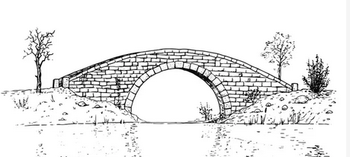
DEC Recommended Practices Are The Bridge
Research to EBPs
Recommended Practices (2014) are:
Research-based and integrate the wisdom and experience of the EI/ECSE profession.
A guide for families and professionals in selecting practices that improve learning outcomes and promote children’s development.
Practices known to promote outcomes for children who are at-risk for or have developmental delays and disabilities and support their families.
Notes:
The DEC Recommended Practices (RPs) (2014) are based on research and the professional wisdom and experience of the field. They serve as an important resource for both families and professionals when identifying EBPs to incorporate into individualized plans.

Slide 11
DEC Recommended Practices (RPs) (2014)
Topic Area | Number of Practices | Example
Leadership | 14 | L4 Leaders belong to professional associations and engage in ongoing evidence-based professional development.
Assessment | 11 | A7 Practitioners obtain information about the child’s skills in daily activities, routines, & environments such as home, center, and community.
Environment | 6 | E2 Practitioners consider Universal Design for Learning principles to create accessible environments.
Family | 10 | F9 Practitioners help families know and understand their rights.
Instruction | 13 | INS6 Practitioners use systematic instructional strategies with fidelity to teach skills and to promote child engagement and learning.
Interaction | 5 | INT1 Practitioners promote the child’s social emotional development by observing, interpreting, and responding contingently to the range of the child’s emotional expressions.
Teaming & Collaboration | 5 | TC1 Practitioners representing multiple disciplines and families work together as a team to plan and implement supports and services to meet the unique needs of each child and family.
Transition | 2 | TR1 Practitioners in sending and receiving programs exchange information before, during, and after transition about practices most likely to support the child’s successful adjustment and positive outcomes.
Notes:
The DEC RPs (2014) include 8 topic areas with a range of 2-14 practices within each topic area. This table identifies the 8 topic areas included in the RPs, the number of practices for each area, and an example of one of the practices for each
topic area. The practices for each topic area can be found at https://www.dec-sped.org/dec-recommended-practices.

Slide 12
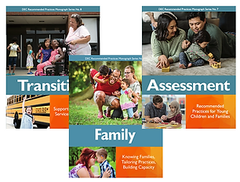
DEC Recommended Practices Monographs
Notes:
A variety of resources have been developed to support the use of the DEC RPs (2014). This includes a monograph series, recommended practice modules, videos, and a document with examples of what the practice would look like in EI/ECSE settings. These resources can all be found at https://www.dec-sped.org/dec-recommended-practices.

Slide 13
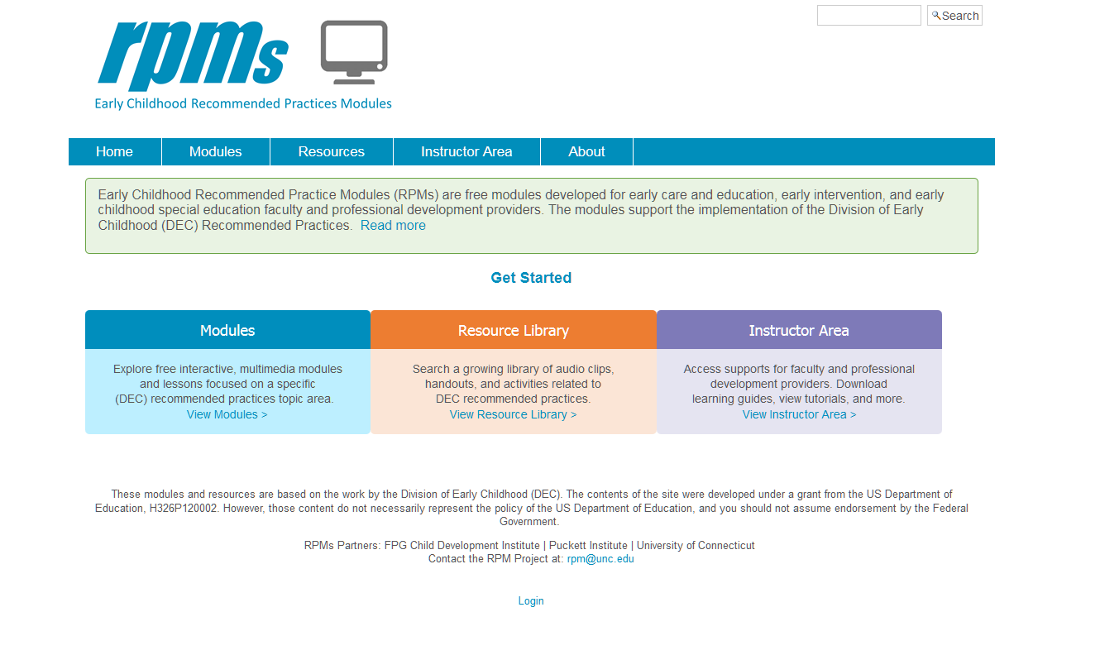

Recommended Practices Modules
http://rpm.fpg.unc.edu/

Slide 14
Other Resources to Support Implementation of EBP in EI/ECSE
CSEFEL: Center on the Social and Emotional Foundations for Early Learning (vanderbilt.edu)
CONNECT | Connect Modules (dec-sped.org)
Early Childhood Technical Assistance Center (ECTA) Evidence-Based Practice Resources
IES What Works Clearinghouse
Notes:
The links on this slide and the next one are additional resources to facilitate the selection and implementation of EBPs.
http://csefel.vanderbilt.edu/#content
https://connectmodules.dec-sped.org/#content

Slide 15
Resources to Support Implementation of EBP in EI/ECSE
IRIS | Evidence-Based Practice Summaries (vanderbilt.edu)
National Center for Pyramid Model Innovations NCPMI (usf.edu)
The National Professional Development Center on Autism Spectrum Disorder
Notes:
https://iris.peabody.vanderbilt.edu/resources/ebp_summaries/#content
https://challengingbehavior.cbcs.usf.edu/

Slide 16
Activity: Applying the RPs
Thinking about your current role, choose one of the DEC RPs topic areas.
    Assessment
    Environment
    Family
    Instruction
    Interaction
    Teaming &
    Collaboration
    Transition
Review the practices within that topic area.
List 2-3 things that you do now consistent with the practices.
List 2-3 things that you would like to do differently.
Notes:
Ask learners to complete the activity individually. Ask for volunteers to share their responses with the group.

Slide 17
Reflective Practice
We don’t learn from experiences; we learn from reflecting on the experience.
-John Dewey

Slide 18
What Is Reflective Practice?
The process by which EI/ECSE professionals examine their own assumptions, values, beliefs, and professional practices and consider actions to be taken to continuously improve their own practice and/or reconstruct their assumptions, values, and/or beliefs.
DEC EI/ECSE Standards Glossary, 2020
Notes:
Reflective practice involves thinking about what we did and how our assumptions, values, and beliefs about children and families, and the intervention/instruction practices that we use have implications for outcomes for children and families.

Slide 19
Reflective Practice
Facilitates the process of ongoing self-awareness,
Supports understanding of one’s professional role within the larger unit of the team,
Requires constant examination of closely-held assumptions and beliefs,
Includes ongoing use of professional standards and research-based resources to examine the selection and use of practices.
(Kucharczyk et al., 2019)
Notes:
Ongoing reflective practice leads to reliance on research-based resources and increased self-awareness or self-efficacy and thus, examination of how our assumptions, values, and beliefs impact our interactions with children and families and to the use of effective EBPs.

Slide 20
Benefits of Reflective Practice
Facilitates use of practices that can be justified and explained to others;
Leads to greater understanding of one’s values, beliefs, and assumptions about learning, intervention, and instruction;
Helps identify areas for improvement, while also recognizing what one is doing well; and
Leads to increased self-efficacy.
Notes:
Reflective practice helps clarify what EI/ECSE professionals are doing and why they are using specific practices, and thus, that can then be conveyed to colleagues and families. Through reflective practice areas for professional growth are identified as well as strengths of the EI/ECSE professional. This leads to greater self-efficacy which we will discuss next.

Slide 21
Self-Efficacy
Practitioner belief that they are effective in the use of their intervention strategies, that children can learn, and that there are resources and knowledge available when they need assistance
(Kucharczyk et al., 2019)
Notes:
Strong self-efficacy is associated with higher levels of family engagement and better child outcomes. When practitioners are confident about their own use of evidence-based practices, family members appear to be more likely to engage with practitioners, ask questions, receive relevant information and feedback, and try out interventions with their own children. When a practitioner is confident about her or his own role and efficacy, there is a greater likelihood that that person will be able to work with cross-disciplinary professionals in a responsive, problem-solving way.

Slide 22
Why Reflective Practice?
Purposeful reflection means not just thinking about our behaviors and their effect on the work we do but doing something about it. “What am I going to do differently in order to better meet student needs?”
-Tony Frontier
Notes:
How do we ensure that we are doing things differently? Reflective practice as an ongoing process can assist in doing things differently.

Slide 23
The Process of Ongoing Reflective Practice
Reflective
Practice
Description
Feelings
Evaluation
Analysis
Conclusion
Action Plan
What happened?
What will I do next time?
What was I thinking? Feeling?
What went well? What did not work?
Which strategy do I choose? Why?
What could I do differently?
Notes:
This figure represents the ongoing reflective practice process that allows us to intentionally analyze what we have implemented and what we might need to do differently in the future. The steps in the process include:
Description – An activity was implemented. And the EI/ECSE professional reflects on what happened.
Feelings – What did the EI/ECSE professional think about what happened? It was a successful activity? How did they feel? They felt good about how it progressed?
Evaluation – What seemed to work well in the activity? Be effective? What did not seem to work? Was not effective?
Analysis – For those aspects of the activity (practices, strategies), what could I do differently based on research, standards, etc.?
Conclusion – Choose one of the EBPs and provide a rationale as to why that EBP is chosen.
Action Plan – Include that practice in the next activity plan and then, continue with the process.

Slide 24
Using Resources to Support Evidence-Based Practice
The following examples of research-based resources to assist in identifying evidence-based strategies when engaging in reflective practice.
EI/ECSE Standards
ECPC Cross-Disciplinary Competencies
DEC Recommended Practice guide with examples
Implementation fidelity tools and checklists (e.g., ECTA Practice Guides)
Notes:
These are some of the resources that you might choose to use in identifying practices at the analysis step of the reflective practice process.
https://www.dec-sped.org/copy-of-pps-home
https://ecpcta.org/cross-disciplinary-competencies/
https://divisionearlychildhood.egnyte.com/dl/b3QfKC3jsp/?
https://www.dec-sped.org/ei-ecse-standards
Official DEC 2014 Recommended Practices with Examples.pdf (egnyte.com)
https://ectacenter.org/decrp/
https://afirm.fpg.unc.edu/learn-affirm

Slide 25
Using Video as a Foundation for Reflective Supervision (5:50)
Watch the video and consider how Jaime may have responded to each of these questions.
What happened?
What was I thinking? Feeling?
What went well? What did not work?
What could I do differently?
Which strategy/practice do I choose? Why?
What will I do next time?
Notes:
Introduce the video. Jaime, a speech-language pathologist, and BJ, her supervisor, illustrate how they use video as a foundation for reflective supervision. BJ and Jaime review and reflect on a video that Jaime shared of a virtual home visit to better support Jaime’s coaching practices.
Ask learners to watch the video and consider each of the six questions in the ongoing reflective process as they watch the video. In small groups, ask learners to discuss their responses to the questions. Then, share in the large group.
https://www.youtube.com/watch?v=JER__EAu-Vg&ab_channel=OhioDevelopmentalDisabilitiesCouncil

Slide 26

Professional Growth Plan
Notes:
Through reflective practice, learners will have identified areas for professional growth. Areas for professional growth may also be identified through a self-assessment of application of the EI/ECSE Standards and feedback from colleagues and/or administrators based on their observations in home and/or classroom settings. A professional growth plan (PGP) will then be developed for these professional growth areas.

Slide 27
What Is a Professional Growth Plan (PGP)?
A PGP is a professional development action plan with goals based on self-assessment of professional standards as they relate directly to the individuals’ professional role.
The PGP includes strategies for achieving the goals.
Evidence is collected to document growth toward achieving the goals.

Slide 28

Developing a S.M.A.R.T. Career Plan (1:51)
Notes:
This video discusses developing a career plan when looking for a new job. We are using the video today to think about how to develop goals for your Professional Growth Plan. The characteristics of goals as discussed in the video provides guidance for developing the PGP goals.

Slide 29
Activity: PGP Goals
Write one SMART goal that you might include in your PGP.
Be sure that the goal is:
S – specific
M – measurable
A – attainable
R – relevant
T – timely
Notes:
After watching the video, ask learners to think about their current role and identify an area for professional growth. For that area of professional growth, write one goal using the S.M.A.R.T. characteristics for goals and be prepared to share the goal with the group. Ask other group members to give feedback on the SMART features of the goal.

Slide 30
References
Buysse, V., Wesley, P. W., Snyder, P., & Winton, P. (2006). Evidence-based practice: What does it really mean for the early childhood field?. Young Exceptional Children, 9(4), 2-11.
Division for Early Childhood. (2014). DEC recommended practices in early intervention/early childhood special education 2014. https://www.dec-sped.org/dec-recommended-practices
Heffron, M. C., & Murch, T. (2012). Finding the words, finding the ways: Exploring reflective supervision and facilitation. California Center for Infant-Family and Early Childhood Mental Health.

Slide 31
References (cont’d.)
Kucharczyk, S., Sreckovic, M.A., & Schultz, T.R., (2019). Practical strategies to promote reflective practice when working with young children with and at-risk for disabilities. Early Childhood Education Journal, 47, pp. 343-352. https://doi.org/10.1007/s10643-019-00932-w
McFarland, L., Saunders, R., & Allen, S. (2009). Reflective practice and self-evaluation in learning positive guidance: Experiences of early childhood practicum students. Early Childhood Education Journal, 36(6), 505-511.
Odom, S. L., & Wolery, M. (2003). A unified theory of practice in early intervention and early childhood special education: Evidence based practices. The Journal of Special Education, 37(3), 164173.

Slide 32
Disclaimer

